Slide 1
NCODA’s 2025 Fall Summit Poster Guidelines & Submission Handbook

Slide 2
NCODA’s 2025 International Fall Summit
Dates: Oct 15-17, 2025
Location: Orlando World Center Mariott
Address: 8701 World Center Dr, Orlando, FL 32821
Overview: The NCODA Fall Summit offers oncology professionals an opportunity to engage with industry experts through educational sessions focused on patient-centered care and medically integrated oncology. The event includes an exhibit hall showcasing innovative products and services aimed at enhancing oncology practices and patient care.

Slide 3
Poster Timeline
Date | Milestone
Mon, June 16 | Abstract submission period begins
Fri, July 18 | Abstract(s) submissions deadline
Fri, Aug 1 | Abstract acceptance/denial and feedback delivered
Mon, Aug 4 | Poster submission period begins
Thur, Aug 14 | 2025 Fall Summit Registration Opens
Fri, Aug 15 | Final abstract(s) resubmission deadline
Fri, Aug 29 | Poster(s) submission deadline
Fri, Sept 12 | Poster acceptance/denial and feedback delivered
Fri, Sept 19 | Schedule for poster showcase delivered
Fri, Sept 26 | Final poster(s) resubmission deadline
Oct 15-17 | Fall Summit
Thur, Oct 16 | Fall Summit Poster Sessions Day 1
Fri, Oct 17 | Fall Summit Poster Sessions Day 2

Slide 4
Poster Timeline – Calendar View
June 2025
Monday | Tuesday | Wednesday | Thursday | Friday
2 | 3 | 4 | 5 | 6
9 | 10 | 11 | 12 | 13
 |  | OPTA |  | Nursing
16 | 17 | 18 | 19 | 20
Abstract Submission Opens |  |  | Juneteenth
23 | 24 | 25 | 26 | 27
30
July 2025
Monday | Tuesday | Wednesday | Thursday | Friday
 | 1 | 2 | 3 | 4
7 | 8 | 9 | 10 | 11
 |  | OPTA | Nursing
14 | 15 | 16 | 17 | 18
 |  |  |  | Abstract Deadline
21 | 22 | 23 | 24 | 25
28 | 29 | 30 | 31

Slide 5
Poster Timeline – Calendar View
August 2025
Monday | Tuesday | Wednesday | Thursday | Friday
 |  |  |  | 1
 |  |  |  | Abstract Acceptance/Denial & Feedback Delivered
4 | 5 | 6 | 7 | 8
Poster Submission Opens |  |  | Nursing
11 | 12 | 13 | 14 | 15
 |  | OPTA |  | Final Abstract Resubmission
18 | 19 | 20 | 21 | 22
25 | 26 | 27 | 28 | 29
 |  | SETs |  | Poster Deadline
September 2025
Monday | Tuesday | Wednesday | Thursday | Friday
1 | 2 | 3 | 4 | 5
Labor Day
8 | 9 | 10 | 11 | 12
 |  | OPTA |  | Nursing
 |  |  |  | Poster Acceptance/Denial & Feedback Delivered
15 | 16 | 17 | 18 | 19
 |  |  |  | Poster Schedule Delivered
22 | 23 | 24 | 25 | 26
 |  | SETs |  | Final Poster Resubmission
29 | 30

Slide 6
Poster Timeline – Calendar View
October 2025
Monday | Tuesday | Wednesday | Thursday | Friday
 |  | 1 | 2 | 3
6 | 7 | 8 | 9 | 10
 |  | OPTA |  | Nursing
13 | 14 | 15 | 16 | 17
Indigenous People's Day |  | FALL SUMMIT | FALL SUMMIT | FALL SUMMIT
20 | 21 | 22 | 23 | 24
27 | 28 | 29 | 30 | 31
 |  | SETs

Slide 7
(III) Hot Topic
(IV) Original Research
(V) Review
Service of Program/Background
Justification/Documentation
Adaptability
Significance
Introduction/Background
Research Question/Hypothesis
Study Design
Methods
Results
Conclusions
Introduction/Background
Methods
Results/Primary Study Points
Discussion
Other
Conclusion
(I) Case Report
Introduction/Background
Case
Discussion
Conclusion
(II) Education/Training
Introduction/Background
Clinical Significance/Service
Justification/Documentation
Adaptability
Significance
Abstract Requirements
NCODA Poster Abstract
2025 Fall Summit
The Main Topic (e.g., Case Reports)
Name and Credentials | Institution, Organization, or University
Email
Header
Title
Learning Objectives
Abstract [≤400 words]
Choose One Main Topic Below:
    Case Report
    Education/Training
    Hot Topic
    Original Research
    Review
References
Body
Your abstract should be labeled under one of the main topics (e.g., III – Hot Topic), but you may adjust the suggested subtitles (e.g., Service or Program/Background) to best suit your content.

Slide 8
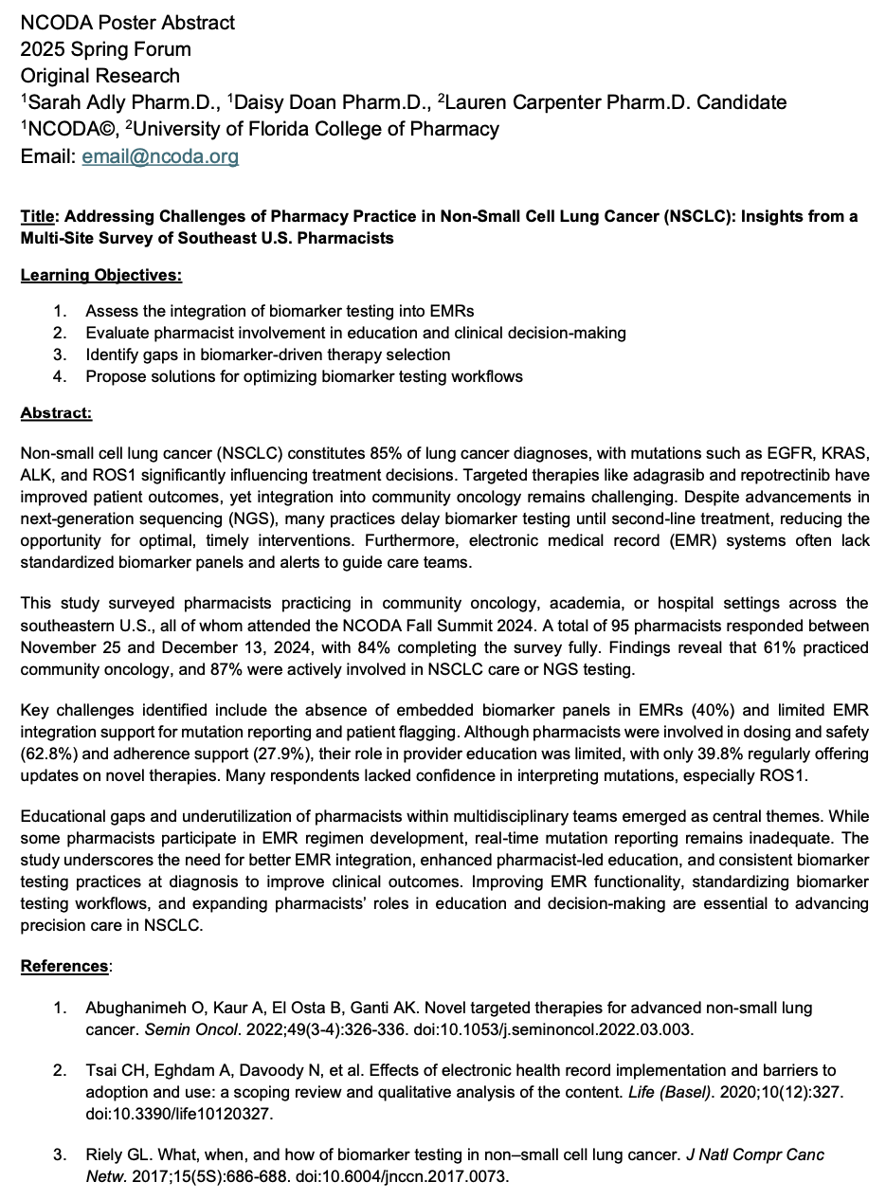

Abstract Example #1

Slide 9
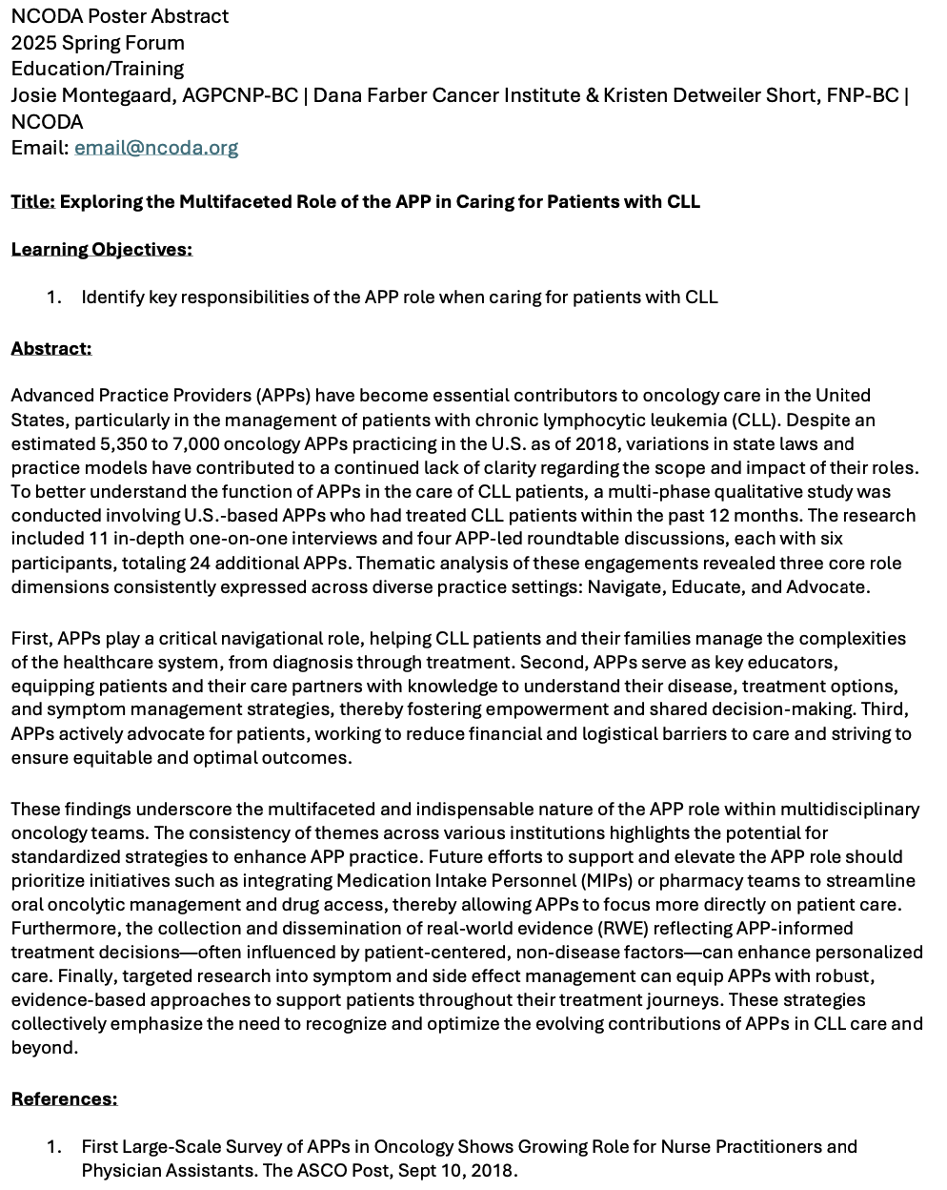
Abstract Example #2

Slide 10
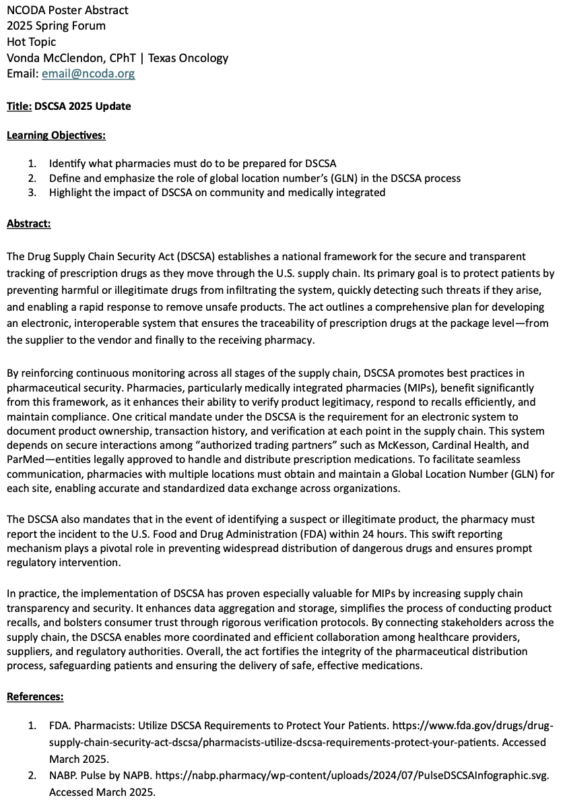
Abstract Example #3

Slide 11
Abstract Submission Instructions
  Complete your abstract and save it as an editable Word document (.doc or .docx)
  Email the abstract with the subject line:
  2025 Fall Summit Abstract – [Poster Title] – [First Name Last Name]
      Send to: posterpresentations@ncoda.org
      CC: your designated committee lead
      Deadline: Fri, July 18
Committee Lead Contacts (CC the appropriate one):
Submitter Role | Committee Lead
Physicians, Pharmacists, & Residents | Natasha.Olson@ncoda.org
Advanced Practice Providers | Shawnny.Eugene@ncoda.org
Nurses | Mary.Anderson@ncoda.org
Pharmacy Technicians | Taryn.Newsome@ncoda.org
Students | Mustafa.Abacioglu@ncoda.org
Industry Partners & Fellows | Jonathan.Rivera@ncoda.org
Research Focused (PhD, MS, MA) | Madelyn.Floysand@ncoda.org

Slide 12
Additional Abstract Information & Next Steps
  You will receive feedback by Fri, Aug 1
  After revisions, submit your finalized abstract via email to posterpresentations@ncoda.org and CC your designated email lead.
  An approved finalized abstract submission is required for your poster to be accepted and featured at the Fall Summit.
  If abstract feedback is provided, your final revised submission is due by Fri, Aug 15
    Email the abstract with the subject line:
  2025 Fall Summit Abstract – [Poster Title] – [First Name Last Name]
      Send to: posterpresentations@ncoda.org
      CC: your designated committee lead
  Begin working on your poster using the approved abstract edits.

Slide 13
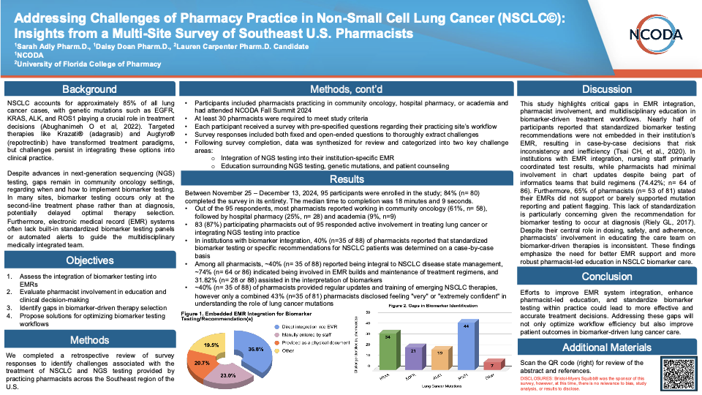
Poster Example #1

Slide 14
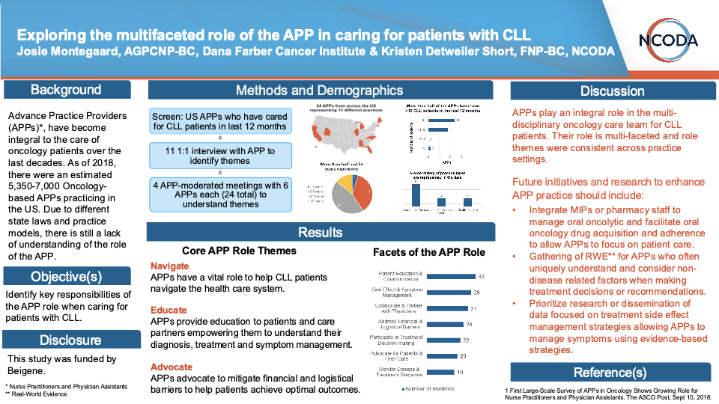
Poster Example #2

Slide 15
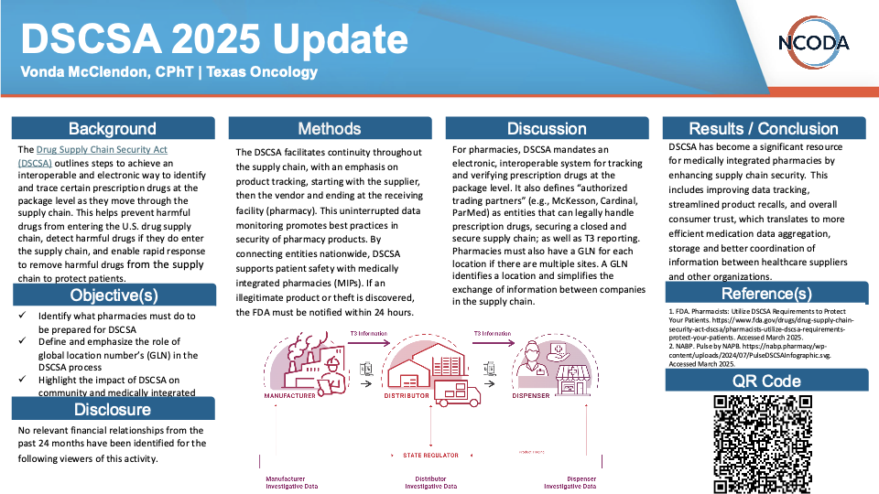
Poster Example #3

Slide 16
Poster Submission
  You can submit your poster by filling out the survey “Spring Forum Poster Submission” found in this link
    The poster submission link will open on Mon, Aug 4
  Please submit your poster by Fri, Aug 29
  If accepted, you will receive feedback on your poster by Fri, Sept 12
  After completing your revisions, please submit your finalized poster via email to posterpresentations@ncoda.org and CC you designated email lead. There is no need to resubmit via the survey.
  You will receive the poster schedule by Fri, Sept 19

Slide 17
Poster Submission Alternative
  If you are unable to submit your poster via Google Forms, you may email it as a PowerPoint (.pptx) or PDF (16:9 ratio, 19020x1080 px, 300 dpi)
  Email the poster with the subject line:
    2025 Fall Summit Poster – [Poster Title] – [First Name Last Name]
    Send to: posterpresentations@ncoda.org
    CC: your designated committee lead
    Deadline: Fri, Aug 29
  Include the following information in your email:
    Your name (First Name Last Name) and associated credentials (if applicable):
    Preferred contact email for the person submitting the poster(s):
    Poster presenter(s) name(s) (First Name Last Name) and associated credentials (if applicable):
    Poster presenter(s) preferred contact email:
    Poster presenter(s) affiliated institution/organization/university:
    Has the poster presenter(s) registered for the 2025 Fall Summit: (Yes/No)
    Names and emails of individuals to include on NCODA poster communications (other than the person submitting or the presenter(s)). List names and emails. If not applicable, type "N/A":
    Poster title (exactly as it appears on the poster):
    Poster category (select one): (Case Report, Education/Training, Hot Topic, Original Research, Review):
    Consent for use of abstract and poster in event materials and online: (Yes/No)
    Are any of the posters being submitted a Trial-in-Progress (TIP) or Encore. If yes, include the poster titles and identify whether each is a TIP or encore. If not applicable, type "N/A":
    Special requests or accommodations needed:

Slide 18
Poster Reminders
  Technical & Design Specifications
  Poster Size: PowerPoint or PDF (16:9 ratio, 19020x1080 px, 300 dpi).
  Display: Posters will be shown on a 65" TV screen.
  Font Size: Minimum 10-14 pt font.
  Font Style: Stick to serif or sans-serif fonts (e.g., Arial, Calibri, Times New Roman).
  Graphics & Images:
    Use high-resolution images. Avoid blurry, pixelated, or stretched graphics.
    Ensure graphs, charts, and visuals are labeled clearly (e.g., axes, legends, units).
    Use text overlays on shapes instead of typing directly into shapes to maintain consistent font size.
    No audio, video, or animations allowed.
  Alignment & Spacing:
    Maintain consistent alignment across all elements. Misalignments are especially noticeable on the large displays.
    Ensure consistent font sizes and styles throughout.
  Color Scheme: Use a professional, high contrast color palette to maximize readability.

Slide 19
Poster Reminders
  Content & Presentation Best Practices
  Title:
    Avoid starting with "A," "An," or "The".
    If applicable, do not include brand names in the title.
  Acronyms: Always spell out acronyms on the first use (e.g., over-the-counter (OTC)).
  References:
    Use American Medical Association (AMA) style for all references, including images.
    If space is limited, you may include a QR code linking to full references or additional materials. Please ensure the QR code works properly and is not set to expire.
  Visual Cues: Consider using callout boxes or arrows to highlight key points or data.
  Language:
    Maintain a professional tone throughout.
    Ensure spelling and grammar are correct. Proofread carefully.
  Presenter Preparation
  Elevator Speech: Prepare a 3-4-minute summary of your poster for the presentation session.
  Practice presenting your poster verbally to ensure clarity and confidence.
  Dress Code Reminder: Business professional attire is expected for the presentation.

Slide 20
Frequently Asked Questions
Is there a submission fee?
  No. There is no fee to submit your poster.
Do you accept Trial-in-Progress (TIP) or Encore posters?
  Yes, with conditions. NCODA currently accepts TIP and Encore Posters:
      Be identified as such during abstract and poster submission.
      Include in the disclaimer that the poster is a TIP or an Encore poster.
  Please note:
      Priority approval will be given to posters that are not TIPs or Encores, as spots are limited.
      If space permits, TIPs and Encores will be considered without issue.
Are submitted posters peer reviewed?
  Yes. All posters and abstracts undergo peer review by the NCODA Poster Committee.
If the first author is not able to attend the congress to present in person who may present on their behalf?
  A co-author may present on behalf of the first author.
  If a pharmaceutical company employee will present on behalf, please inform us of their name and company during submission.
  The designated presenter must be registered for the 2025 Spring Forum.
Do I need to prepare a printed version of the poster?
  No. Posters will be displayed on a 65" TV screen during the presentation. A printed version is not required.
Am I required to use the NCODA poster template?
  No. The NCODA poster template is not required. It is simply provided as a resource to help you get started. If you have an existing company or organization poster, you are welcome to use your own template.
Are posters published anywhere?
  Posters and abstract will be published:
      On the NCODA website
      In Summit Rewind or Forum Rewind (Only for their respective conference)
      In the NCODA Journal of Oncology Abstracts (NJOA)

Slide 21
Support & Contacts
  For questions or assistance, please contact: posterpresentations@ncoda.org
  CC: your community leads
  We're happy to assist with any questions regarding abstract/poster submissions, formatting, deadlines, or logistics!
Committee Lead Contacts (CC the appropriate one):
Submitter Role | Committee Lead
Physicians, Pharmacists, & Residents | Natasha.Olson@ncoda.org
Advanced Practice Providers | Shawnny.Eugene@ncoda.org
Nurses | Mary.Anderson@ncoda.org
Pharmacy Technicians | Taryn.Newsome@ncoda.org
Students | Mustafa.Abacioglu@ncoda.org
Industry Partners & Fellows | Jonathan.Rivera@ncoda.org
Research Focused (PhD, MS, MA) | Madelyn.Floysand@ncoda.org

Slide 22
Poster Templates

Slide 23
Title
Name(s) | Name of Organization
Background
Methods
Discussion
Results / Conclusion
State the purpose of the research and summarize the current knowledge, the knowledge gap, and how the research project proposes to address the knowledge gap.
Describe the approach, including study design, participants, data collection, and analysis methods.
Interpret the results, highlighting their significance, implications, and potential limitations.
Summarize the key findings of the project or research, often with the support of data tables or figures.
REPLACE WITH GRAPHICS: (charts, graphs, diagrams, etc.) that effectively convey the data or concepts.
Reference(s)
Ensure all literature, data, prior work, graphics, etc., referenced in the presentation are properly cited.
Objective(s)
Disclosure
Identify the specific aims or research questions the project seeks to answer.
Disclose all financial or personal relationships that could influence the research or outcomes.

Slide 24
Title
Name(s) | Name of Organization
Background
Methods
Discussion
Results / Conclusion
State the purpose of the research and summarize the current knowledge, the knowledge gap, and how the research project proposes to address the knowledge gap.
Describe the approach, including study design, participants, data collection, and analysis methods.
Interpret the results, highlighting their significance, implications, and potential limitations.
Summarize the key findings of the project or research, often with the support of data tables or figures.
Objective(s)
REPLACE WITH GRAPHICS: (charts, graphs, diagrams, etc.) that effectively convey the data or concepts.
Reference(s)
Identify the specific aims or research questions the project seeks to answer.
Ensure all literature, data, prior work, graphics, etc., referenced in the presentation are properly cited.
Disclosure
Disclose all financial or personal relationships that could influence the research or outcomes.

Slide 25
Title
Name(s) | Name of Organization
Background
Methods
Discussion
Results / Conclusion
State the purpose of the research and summarize the current knowledge, the knowledge gap, and how the research project proposes to address the knowledge gap.
Describe the approach, including study design, participants, data collection, and analysis methods.
Interpret the results, highlighting their significance, implications, and potential limitations.
Summarize the key findings of the project or research, often with the support of data tables or figures.
Objective(s)
REPLACE WITH GRAPHICS: (charts, graphs, diagrams, etc.) that effectively convey the data or concepts.
Reference(s)
Identify the specific aims or research questions the project seeks to answer.
Ensure all literature, data, prior work, graphics, etc., referenced in the presentation are properly cited.
Disclosure
Disclose all financial or personal relationships that could influence the research or outcomes.

Slide 26
Title
Name(s) | Name of Organization
Background
Methods
Discussion
Results / Conclusion
State the purpose of the research and summarize the current knowledge, the knowledge gap, and how the research project proposes to address the knowledge gap.
Describe the approach, including study design, participants, data collection, and analysis methods.
Interpret the results, highlighting their significance, implications, and potential limitations.
Summarize the key findings of the project or research, often with the support of data tables or figures.
Objective(s)
REPLACE WITH GRAPHICS: (charts, graphs, diagrams, etc.) that effectively convey the data or concepts.
Identify the specific aims or research questions the project seeks to answer.
Reference(s)
Ensure all literature, data, prior work, graphics, etc., referenced in the presentation are properly cited.
Disclosure
Disclose all financial or personal relationships that could influence the research or outcomes.

Slide 27
Title
Name(s) | Name of Organization
Background
Methods
Discussion
Results / Conclusion
State the purpose of the research and summarize the current knowledge, the knowledge gap, and how the research project proposes to address the knowledge gap.
Describe the approach, including study design, participants, data collection, and analysis methods.
Interpret the results, highlighting their significance, implications, and potential limitations.
Summarize the key findings of the project or research, often with the support of data tables or figures.
Reference(s)
Ensure all literature, data, prior work, graphics, etc., referenced in the presentation are properly cited.
Objective(s)
REPLACE WITH GRAPHICS: (charts, graphs, diagrams, etc.) that effectively convey the data or concepts.
QR Code
Identify the specific aims or research questions the project seeks to answer.
REPLACE WITH QR CODE TO LINK SUPPLEMENTAL MATERIAL
Disclosure
Disclose all financial or personal relationships that could influence the research or outcomes.

