Slide 1
IV & Oral Best Practice Coordination
Emily Zimdars, BA, CPhT, M Health Fairview
Paul Morales, PharmD, BCOP, M Health Fairview
Brandi Gudwien, CPhT, Alabama Oncology
Austin Cox, PharmD, Alabama Oncology
Notes:
Title: “IV and Oral: Best Practice Coordination”
Presented by: Emily Zimdars and Paul Morales, M Health Fairview and Brandi Gudwien and Austin Cox, Alabama Oncology
Intro by: Kevin Scorsone

Slide 2
Who Are We?
M Health Fairview
Alabama Oncology
Large academic health system
10 hospitals and 60 clinics
A community-based physician practice
7 clinic locations
Notes:
Emily - M Health Fairview is the newly expanded collaboration among the University of Minnesota, University of Minnesota Physicians, and Fairview Health Services. The healthcare system combines the best of academic and community medicine -– expanding access to world-class, breakthrough care through our 10 hospitals and 60 clinics.
Brandi - Alabama Oncology is a community-based practice that provides patients with increased access to integrated, evidence-based cancer care and clinical research throughout central Alabama. Our seven locations have a total of 18 medical oncologists, 2 gynecologic oncologists, 1 general oncology surgeon, 1 hepatobiliary/pancreatic surgeon, 3 advanced practitioners​​, as well as numerous nurses and support staff.

Slide 3
IV – M Health Fairview
4 stand-alone outpatient infusion pharmacies
30 Pharmacists
27 Pharmacy Coordinators (Technicians)
12 Pharmacist Interns (P1-P4)
2 PGY2 (Oncology) (Primary Site)
23 Infusion Finance Intake Specialists
IV & Clinically Administered Medications (CAM)
8 Pharmacy Liaisons (Oral Oncology)
Notes:
Paul ~Talk about difference in Pharmacy Coordinators – more responsibilities, etc.
~At our largest infusion pharmacy site, we see roughly 150 Oncology and Non-Oncology patients per day (infusions); roughly 200 clinic visits
~Learners (12-15 APPE's/year, IPPE's, PGY1 rotations as well
~Joint Commission & Commission on Cancer

Slide 4
IV –Systems We Use
Epic – Beacon
ClinicalPath (formerly VIA Oncology)
CSTD - Equashield
Epic dispense prep/dispense check/picture capture
Microsoft Office
24-hour remote temp monitoring of fridges and backup
Notes:
Emily -Compounding and Repackaging - pre-medication compounding
-Utilize Surface Pro Tablets at each hood

Slide 5
IV –Workflow
Orders entered
Order is compounded and delivered to nursing bay
Patient infused
Patient scheduled
2 days in advance: Pharmacist starts patient work-up
Decision made for IV therapy
Referral auto generated for Infusion Intake Team
3 days in advance: Coordinator completes patient work-up
Day of Infusion: RN assesses patient and releases order
Pharmacist double check of order
Notes:
Emily

Slide 6
IV - Last Minute Add On
Orders entered and signed
Pharmacy alerted - stock check
Pharmacist works up patient like normal process
Patient Infused
Patient scheduled
RN assesses patient and releases order
Email sent to Infusion Finance team for benefit check (15-30 min)
Notes:
Paul - If we don’t have it in stock, we can use our health system network to obtain the medication.

Slide 7
IV - Hybrid Patients (Patients on IV + OC)
Ideal – Filling Onsite
Using FVSP (Fairview Specialty Pharmacy) or other specialty pharmacies to fill – less flexibility
Flagged and patient worked up in advanced (including infusion intake/OC liaisons)
Integrated/Cross Trained Staff (pharmacist)
Notes:
Paul -Filling onsite – reduce waste, you know the patient received the drug, properly counseled, we have a variance to counsel on behalf of the retail pharmacy in the building
-Contingent on patients' insurance – we can fill roughly 2/3 through the Fairview network
-Flagged and patient worked up in advanced (including infusion intake/OC liaisons); intake and liaison report back to RPH that the patient is good with coverage separately

Slide 8
IV – Best Practices
CNR (Compounding and Repackaging) & Serial Dilutions
Advanced Prep
USP 797/800 – Policies and procedures (cleaning, compounding, etc.)
Expiring Drugs Tracker
Site | NDC | Drug | Strength | Exp Date | Quantity
UMMC -E | 0002-7669-01 | Cyramza | 100mg/10mL | 5/31/2021 | 1
MG | 0006-3025-00 | Zinplava | 1000mg/40mL | 11/20/2021 | 1
MG | 57894-060-03 | Stelara | 45mg/0.5mL syringe | 6/30/2021 | 1
Ridges | 70510-2171-2 | Radicava | 30mg/100ml (box of 2) | 10/31/2021 | 5
CSC | 61703-418-18 | Aquasol A | 50000U/ml 2ml vial | 7/31/2021 | 5
SD | 71336-1000-1 | Onpattro | 10mg/5ml | 11/31/21 | 5
CSC | 0904-6618-61 | Hyrdoxyzine 50mg tablets | 50mg | 5/31/2021 | 200 tabs
Lakes | 67457-153-03 | Amiodarone 50mg/ml | 3ml vials | 4/30/2021 | 10 vials
Notes:
Paul -CNR – build formulations that include references within Epic for stability. It will automatically print RPH/CPhT initials on label. It can distinguish the medication, cannot distinguish the dose. No picture capture on these yet.
Paul-CNR also used for serial dilutions for oxaliplatin/carboplatin desensitization
Paul -We prepare cheaper hazardous medications in advance to efficiently handle the "bottle necks" throughout the day
Emily-We reference USP 797 and 800 for system policies and procedures that are specific to acute care (iso 7 environments) and segregated compounding areas (infusion pharmacies). Standard cleaning products and procedures across system

Slide 9
IV – Best Practices (cont.)
Schedule Prep – Pharmacy Coordinators
In Epic:
Confirm orders are in Epic
Confirm orders are signed by provider
Confirm insurance coverage
In OneNote
Document details of appointment in notes
Confirm inventory supply
Example -->
Notes:
Emily

Slide 10
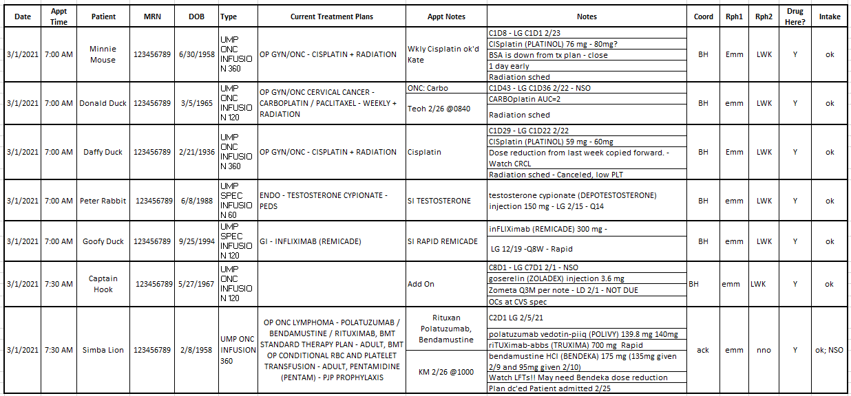
Notes:
Paul

Slide 11
Oral – Alabama Rx
Medically-integrated dispensing oral pharmacy for Alabama Oncology
Services all 7 clinic sites, including supportive care ​​
1 Pharmacist​, 3 Certified Pharmacy Technicians / Patient Advocates
Internal courier service
URAC and ACHC accredited
Notes:
Brandi
Each month on average, we care for 350 - 400 patients. For 2020, we obtained almost a million dollars in financial assistance for patients.

Slide 12
Oral – Systems We Use
OncoEMR ​
Clinic enters treatment plans for IV and escribe oral medications to the pharmacy​
Pharmacy accesses treatment plans and schedules, as well as communicates with clinic via tasks
PioneerRx​
Process prescriptions
Maintain pharmacy care plans generated using Vital Source Care Plans
Inventory management
NCODA resources ​
PQIs, Treatment Support Kits and Calendars, OCEs​, Waste tracker
Notes:
Austin
Expand on communication between pharmacy and clinic (nurses and patient financial counselors) via tasks, phone, teams, etc

Slide 13
Oral – Best Practices
Initial fill – Treatment plan created, and script received​​
Verify script and treatment regimen
Evaluate the need for supportive medications (antiemetic, antidiarrheal, mouth rinse) based on treatment regimen​​
Benefits investigation - prior authorization/overrides​
Financial assistance (copay savings voucher, foundation assistance, PAP)
Clinic notification of medication delivery/pick up​ or any delays
Refill call/reassessment - Begins 7-10 days prior to need date
Check EMR for any changes in therapy (held/discontinued) due to toxicities
If needed, start transfer process to specialty pharmacy or manufacturer's PAP
Transfers
Limited distributions, PBM Mandate, No funding, Patient Preference
Pull PAP application for clinic patient financial counselor
Troubleshoot with specialty pharmacy on behalf of nurses
Inform patient of pharmacy name and contact number
Notes:
Brandi - We follow the NCODA/ASCO/ACCC standards. Pharmacy Care Plans help identify adherence, address areas of concern, and implement PQIs.
Troubleshooting - Confirm script is received. Provide demos, meds list, etc. Notify clinic of any delays
Pharmacist and nurses utilize PQIs to address best way to mitigate adverse effects. . . For 2020, we continued to service 70-75% of our patients without sending to outside pharmacies or PAP. . . . .PAP application process – We provide the clinic's patient financial counselor with the application, a print-out showing patient's out-of-pocket cost (copay/deductible), copies of insurance cards, prior authorization approval, and proof of exhausted grant funding (when applicable).

Slide 14
Oral – Best Practices
Patient Management Program
Enroll patient in Vital Source Care Plan
Patient Education – three-pronged approach
Physician – initial discussion / counseling with patient
Oral Chemo Nurse – review and obtain patient consent
Pharmacist – counseling
Initial consult at start of medication
7 day follow up call
21 day follow up
Adverse Event Management
Adherence Assessment
Notes:
Austin

Slide 15
Oral – Last minute add-ons
Last minute add-ons / issues
Examples: Change in treatment, adding a supportive medication, change in insurance benefit
Lead time:
Medicare Part D – prior authorizations take longer due to prescription benefit process
Utilize manufacturer resources
Communication with clinic and IV pharmacy
Notes:
Brandi - Most oral oncolytics aren’t last minute for AL Rx. Scripts are typically sent with at least 4-5 day advance. We expedite each step of the process to prevent a delay. The average processing time is 3 ½ days from order entry to delivery.

Slide 16
Questions?
Notes:
Q&A: Kevin field questions to panel

Slide 17
Notes:
Our next sessions are the concurrent Continuing Education breakout sessions from 4:30 – 5:30 pm Eastern
Please attend the session that you registered for by visiting the auditorium on virtual meeting site

