Slide 1
White (Brown & Clear) Bagging
Ray Bailey RPh, VP Pharmacy, Florida Cancer Specialists
Bob Phelan RPh, CEO, Cancer Specialists of North Florida
Debra Patt MD Phd, EVP, Texas Oncology
Notes:
Presentation Title: “Breaking Down the Practice of White, Brown and Clear Bagging in Oncology”
Presented by: Ray Bailey, Vice President of Pharmacy at Florida Cancer Specialists, Bob Phelan, CEO of Cancer Specialists of North Florida and Dr. Debra Patt, Executive Vice President at Texas Oncology
Intro by: Kevin Scorsone

Slide 2
Overview (White, Brown, Clear) Bagging Patient Risks Supply chain challenges Hazard Lack of Just in Time Inventory management Examples

Slide 3
When a payer mandates that a specialty pharmacy ships medication directly to a prescribers office or infusion center for administration.
White Bagging
When a payer mandates that a medicine is shipped from their pharmacy of choice to be mailed to the patient directly. The patient then is responsible for bringing the drug to the office or infusion center for treatment.
Brown Bagging
Clear bagging: A provider’s internal specialty pharmacy dispenses the patient’s prescription and transports the product to the location of drug administration.
Clear Bagging

Slide 4
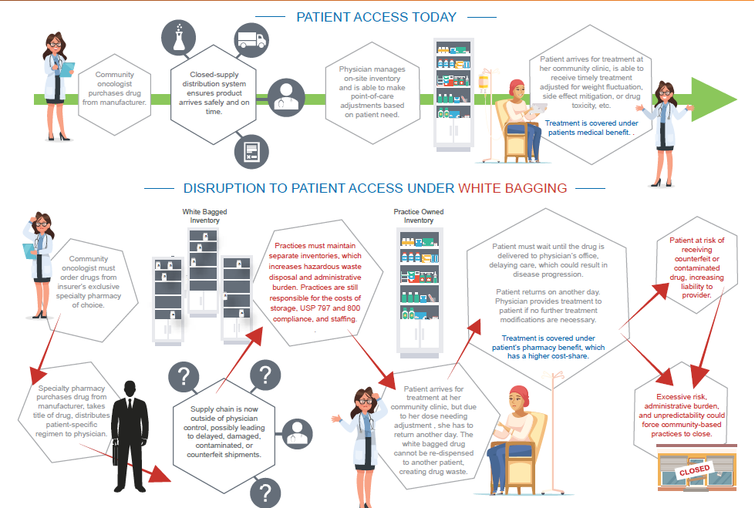

Slide 5
White Bagging Hazards
Supply chain safety
Just in time inventory to treat patients in a timely way. White bagging deliveries are often late or incorrect creating treatment delays
Acute requirement for dose adjustments– weight, kidney function, liver function
Acute needs to change therapy. On-site lab blood chemistries could change or delay therapy
Patient out of pocket costs could be wasted creating more financial toxicities

Slide 6
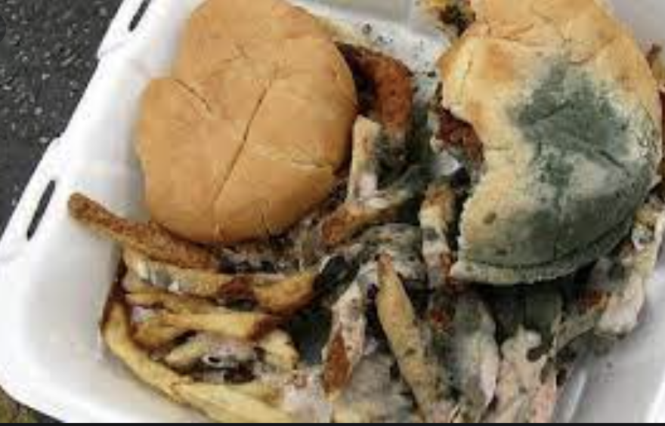
Brown Bagging Hazards
Brown bagging delivers drug to patient that they then bring to clinic for administration
Would anyone eat food that someone left on your front doorstep at a temperature that was not controlled? Do you think about it differently with a highly sensitive biologic product?

Slide 7
Patient Safety
Non-medically integrated Specialty Pharmacies do not provide the same pharmaceutical surveillance and safeguards that medically integrated community pharmacies do
Lack up-to-date clinical information (labs, notes and medication lists)
Unable to accurately screen for drug interactions and contraindications
Unable to insure inadvertent or improper ordering of medication increasing the chances of medication errors
Makes it difficult to identify and quarantine recalled products
Drug pedigree, storage and handling of product from manufacturer to patient cannot be insured. (Pharmacy/Wholesaler law implications)
Practice must take liability for all of the above

Slide 9
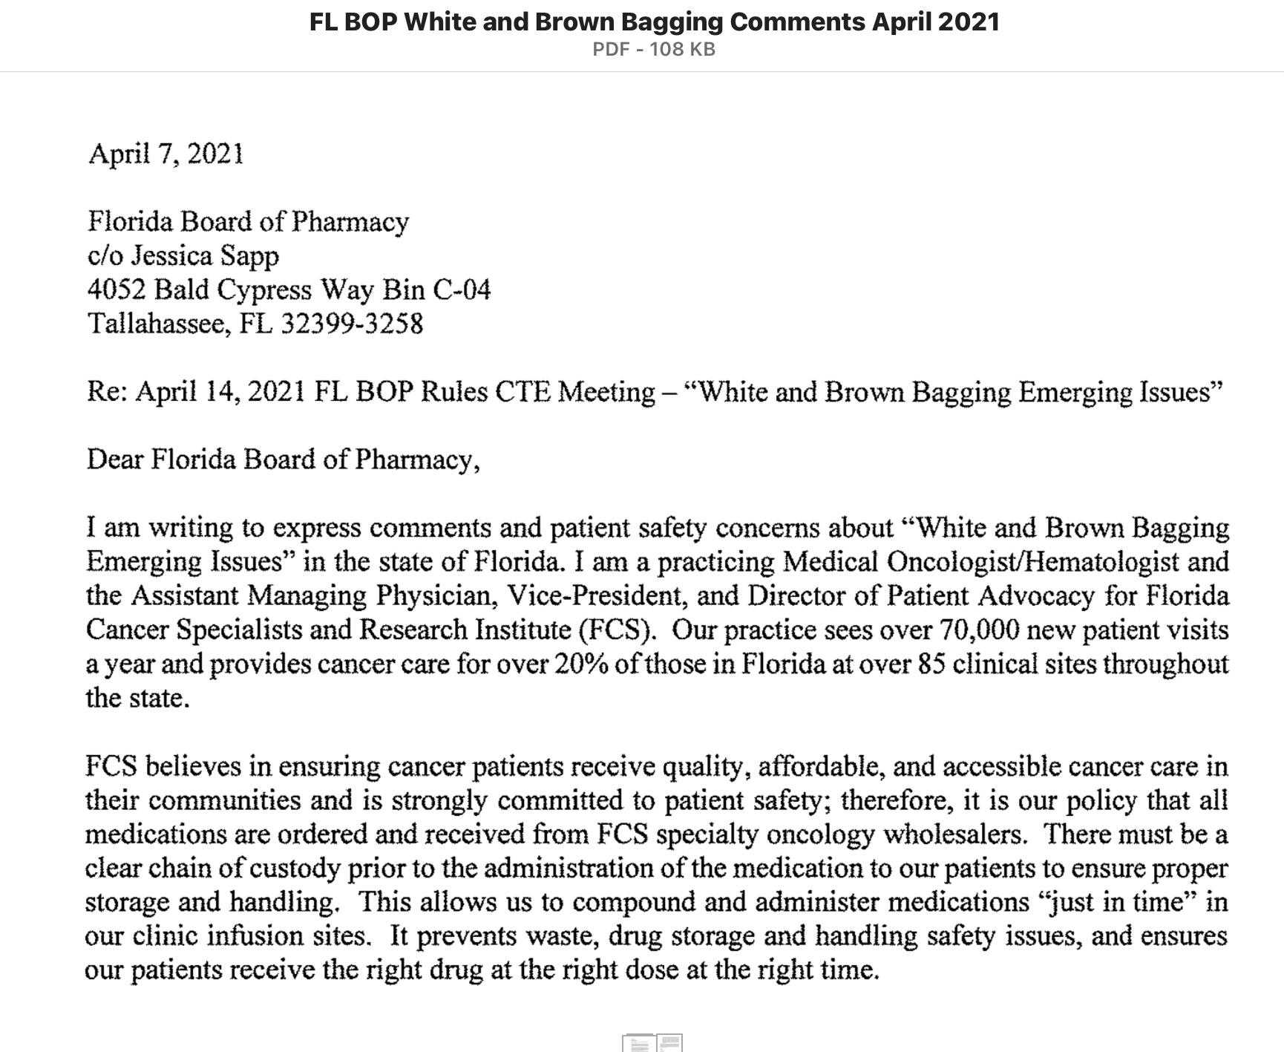

Slide 10
Questions?
Notes:
Q&A moderated by Kevin

