Slide 1
Late Stage Breast Cancer,
Including SABCS Updates
William J. Gradishar, MD, FASCO, FACP
Betsy Bramsen Professor of Breast Oncology
  Robert H. Lurie Comprehensive Cancer Center of Northwestern University

Slide 2
ER+ Metastatic Breast Cancer
Notes:
Section break/subtitle slide

Slide 3
Learning Objectives
Where are we?
Focus on resistance mechanisms
  ER mutations and implications
  CDK4/6 inhibitors
  mTOR inhibitors
  PI3K inhibitors

Slide 4

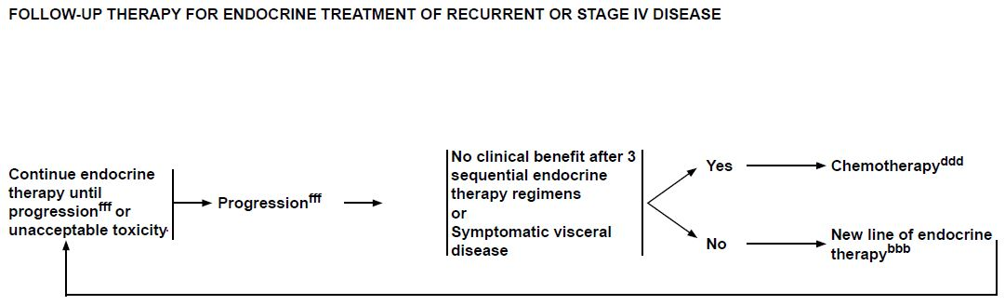
© 2017 National Comprehensive Cancer Network, Inc. All rights reserved. These guidelines and this illustration may not be reproduced in any form without the express written permission of NCCN®. To view the most recent and complete version of the NCCN Guidelines, go to NCCN.org.

Slide 5
Combatting Endocrine Resistance
60%-70% of breast cancers are hormone receptor positive; current treatments aim to decrease estrogen levels or block the estrogen receptor
Some cancers are refractory to such therapies initially (de novo resistance), and unfortunately others become resistant over time (acquired resistance)
Resistance to estrogen deprivation involves activation of growth factor pathways to bypass endocrine dependence
Novel therapeutics are needed to combat endocrine therapy resistance

Slide 6
Endocrine Therapy for Metastatic ER+ Breast Cancer
Timeline of FDA Approvals of First-Line HR+ MBC Treatments*
Palbociclib
+ letrozole
Exemestane
Toremifene
Fulvestrant
2015
Letrozole
Tamoxifen
Everolimus + exe
1997
1999
Anastrozole
2002
1977
2015
1995
1970
1980
1990
2000
2010
Notes:
For HR+/HER2- MBC, IBRANCE + LETROZOLE IS THE first advance in
FIRST-LINE TREATMENT IN OVER A DECADE
The aromatase inhibitors anastrozole, letrozole, and exemestane; the antiestrogen, or selective ER downregulator (SERD), fulvestrant; and the estrogen agonists and antagonists, or selective ER modulators (SERMs), toremifene and tamoxifen, were approved between 1977 and 2002 for the treatment of MBC^{1,2}
REFERENCES
American Cancer Society. Breast cancer. http://www.cancer.org/acs/groups/cid/documents/webcontent/003090-pdf.pdf. Accessed April 19, 2016.
US Food and Drug Administration. FDA approved drug products. http://www.accessdata.fda.gov/scripts/cder/drugsatfda/index.cfm?fuseaction=Search.DrugDetails. Accessed April 19, 2016.

Slide 7
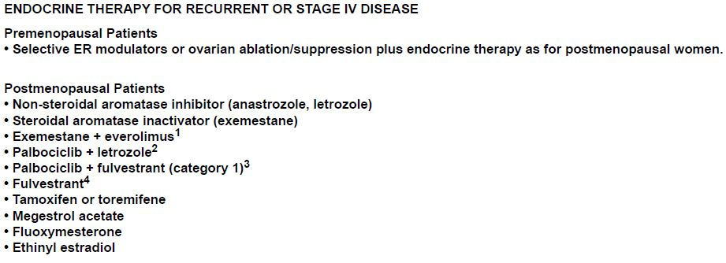

© 2017 National Comprehensive Cancer Network, Inc. All rights reserved. These guidelines and this illustration may not be reproduced in any form without the express written permission of NCCN®. To view the most recent and complete version of the NCCN Guidelines, go to NCCN.org.

Slide 8
Are we arriving at the convergence of precision medicine and routine clinical care?

Slide 9


Whole exome and transcriptome sequencing of resistant ER+ metastatic breast cancer
SABCS 2016
S1-01
Ofir Cohen, Dewey Kim, Jorge Buendia, Esha Jain, Seth Wander,
Coyin Oh, Ada Waks, Nelly Oliver, Karla Helvie, Lori Marini, Asaf Rotem, Max Lloyd, Dan Stover, Victor Adalsteinsson, Samuel Freeman, Gavin Ha, Carrie Cibulskis, Kristin Anderka, Cory Johannessen, Ian Krop, Levi Garraway, Eric Winer, Nancy Lin, Nikhil Wagle

Slide 10
Study design and genomic methods
149 metastatic biopsies with ER+ metastatic breast cancer 44 matched primary tumors
  Prospective IRB-approved bx protocol
  >95% of patients received at least 1 ER directed therapy (tamoxifen, AI, fulvestrant) prior to biopsy
  Whole Exome Sequencing (WES) of tumor and germline
    149 metastatic biopsies, 44 matched primary tumor
  Transcriptome Sequencing (RNA-seq) of tumor
    128 metastatic biopsies
Goals:
What is the genomic landscape of ER+ metastatic breast cancer following ER targeted therapy?
What are the evolutionary changes that can occur between ER+ primary and resistant metastatic breast cancer?
Cohen et al, SABCS 2016, S1-01
Notes:
44 matched from 40 patients.

Slide 11
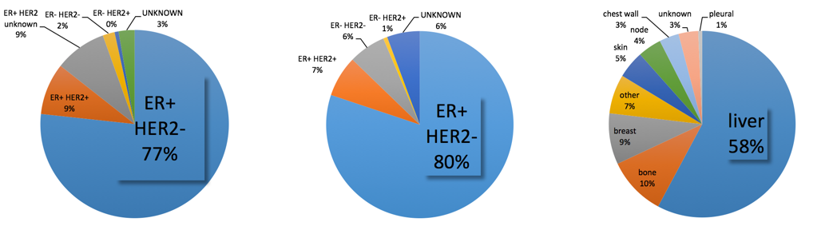
Tumor characteristics
RECEPTOR STATUS OF METASTATIC BIOPSY
RECEPTOR STATUS AT DIAGNOSIS
SITE OF MET BIOPSY
ER/HER2 Receptor Changes:
6 ER+ to ER-
7 HER2+ to HER2-
5 HER2- to HER2+
Cohen et al, SABCS 2016, S1-01
Notes:
highlight ER changes as percent of total, HER2 gain as percent of HER2-,
HER2 loss of percent of HER2+

Slide 12
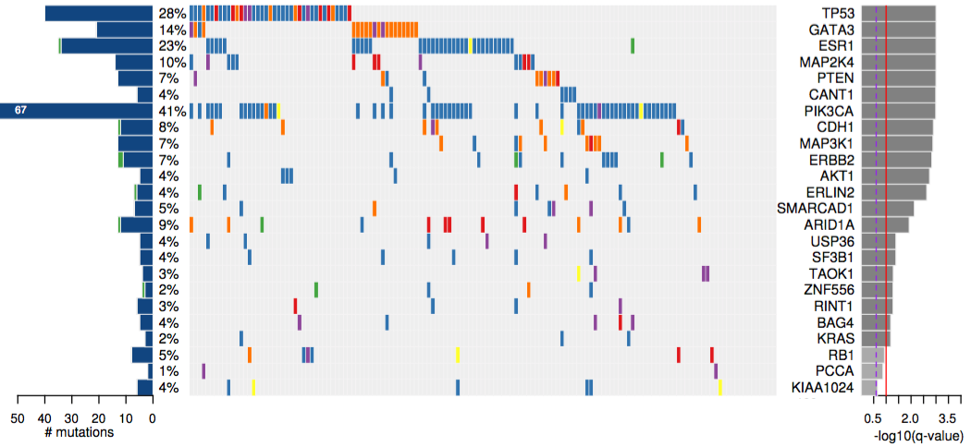
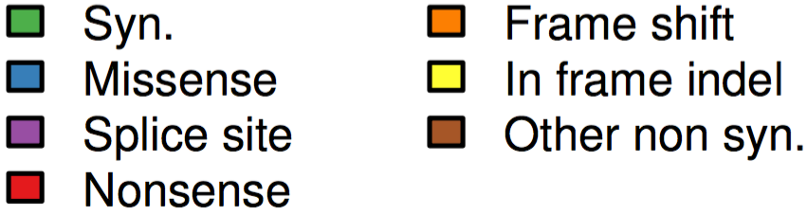
Mutational landscape of ER+ MBC significant genes with SNV and indel alterations
SNV = single nucleotide variant
N=141
Method: “MutSig” – Lawrence et al, 2014
Cohen et al, SABCS 2016, S1-01
Notes:
These are the significant recurrently mutated genes in the MBC cohort
Explain plot
Many of the genes we see here as significantly mutated are also found to be significantly mutated in primary ER+ breast cancer – for example TP53, GATA3, PIK3CA [Animations with arrows outside these specific genes]
We also see genes on this
-- additional novel genes are being prioritized by integration with functional genomic screens from our group and (and collaborators) and others

Slide 13

Tumor Evolution - Acquired Metastatic Alterations
Primary
Metastatic
Pre-treatment
Post-progression
3 Evolutionary-based annotations of Metastatic setting Events:
Acquired (not observed in primary tumor)
Shared (also observed in primary tumor)
Unknown (primary tumor status unknown)
Directly compare the metastatic sample to it’s matched-primary from the same individual
Cohen et al, SABCS 2016, S1-01

Slide 14
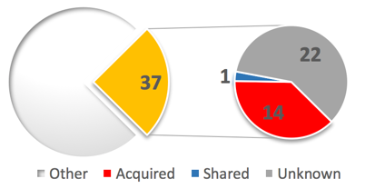
Acquired ESR1 Mutations* in ER+ MBC
ESR1
ESR1 mutations in 23%
93% of ESR1 mutations (14/15) in metastatic samples with matched primaries were acquired.
Y537N/S
D538G
Acquired (not observed in primary tumor)
E380Q
Shared (also observed in primary tumor)
Unknown (primary tumor status unknown)
M421del
G442R
V51A
S463P
Hormone-binding Domain
*Abstract 4-02 for mechanistic role of ESR1 mutations in metastatic process
Cohen et al, SABCS 2016, S1-01
Notes:
537: 11+7
538: 6+3
380: 2+3+1
11+7+6+3+2+3+1+3 = 36
+1 in_frame_del
Nick: in 260_T1 we have observed "p.E380Q” and also in 260_Archival1.
But 260_T1 is denote as Breast (thus, actually not in the key samples set.
Acquired.all
043_Prospective1.p.D538G, 320_T1.p.M0del, 318_T1.p.D538G, 316_T2.p.Y537N, 313_T1.p.D538G, 295_T2.p.E380Q, 295_T1.p.E380Q, 288_T2.p.Y537S, 288_T1.p.Y537S, 284_T1.p.E380Q, 259_Prospective1.p.Y537N, 191_Prospective1.p.Y537S, 191_T1.p.Y537S, 177_Prospective1.p.Y537S
PreExisting
260_T1.p.E380Q
Unknown
013_Prospective1.p.V51A, 048_Prospective1.p.D538G, 071_T1.p.D538G, 157_Prospective1.p.E380Q, 169_Prospective1.p.D538G, 190_Prospective1.p.E380Q, 268_T1.p.Y537S, 294_T2.p.G442R, 329_T1.p.D538G, 333_T1.p.Y537C, 335_T1.p.Y537S, 374_T1.p.Y537C, 386_T1.p.Y537S, 386_T1.p.D538G, 397_T1.p.Y537S, 425_T1.p.Y537S, 075_Prospective1.p.S463P, 102_Prospective1.p.Y537S, 103_Prospective1.p.D538G, 136_Prospective1.p.Y537S, 143_Prospective1.p.Y537N, 214_Prospective1.p.Y537S

Slide 15
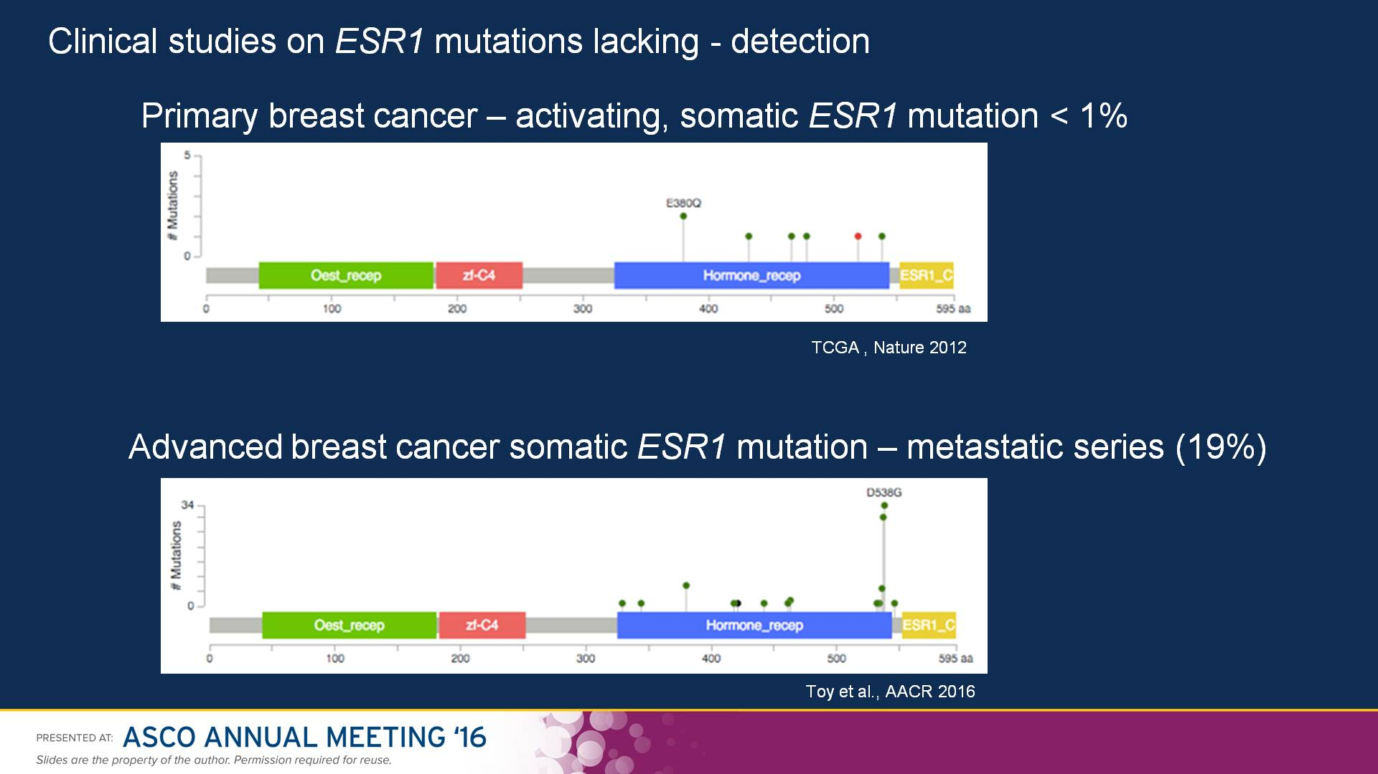
Slide 4

Slide 16
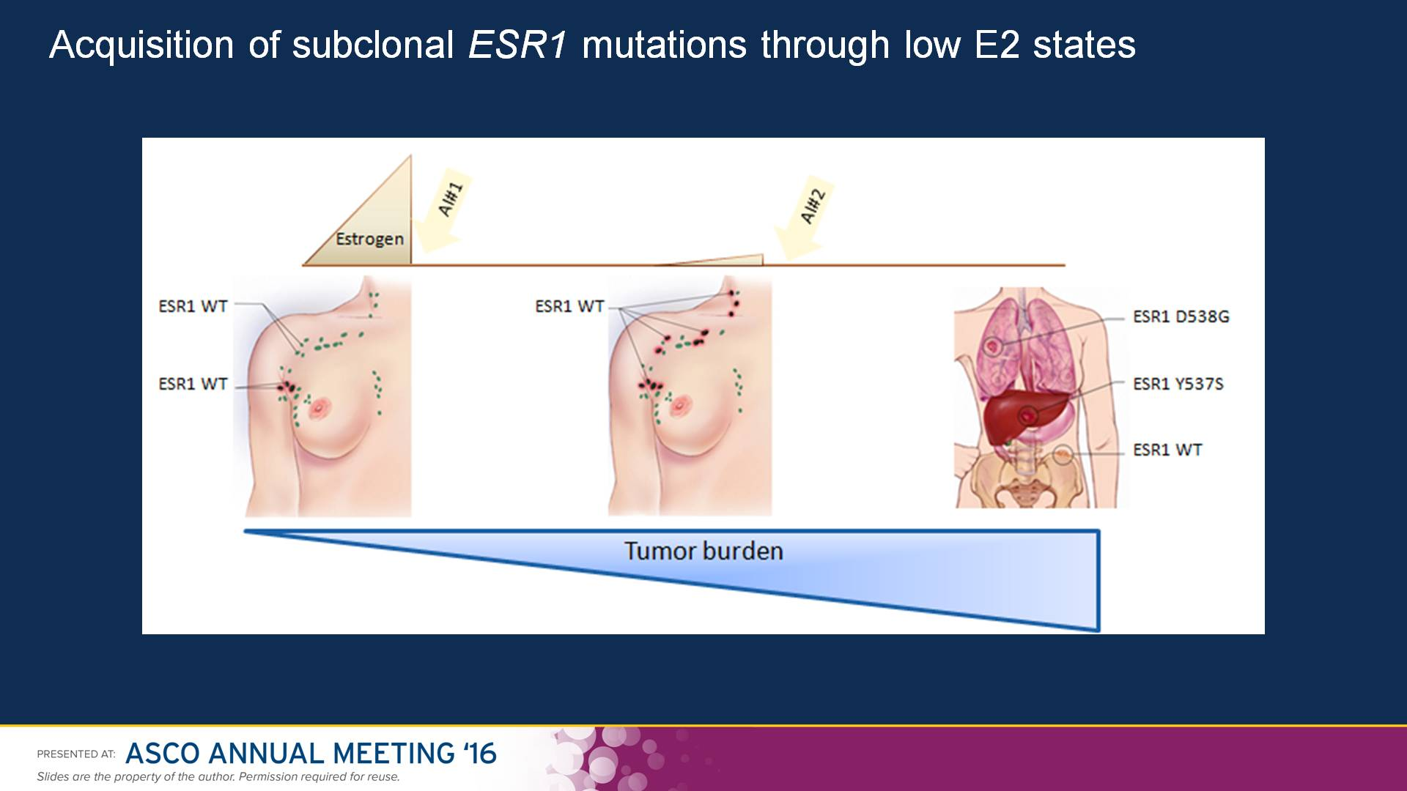
Slide 10

Slide 17
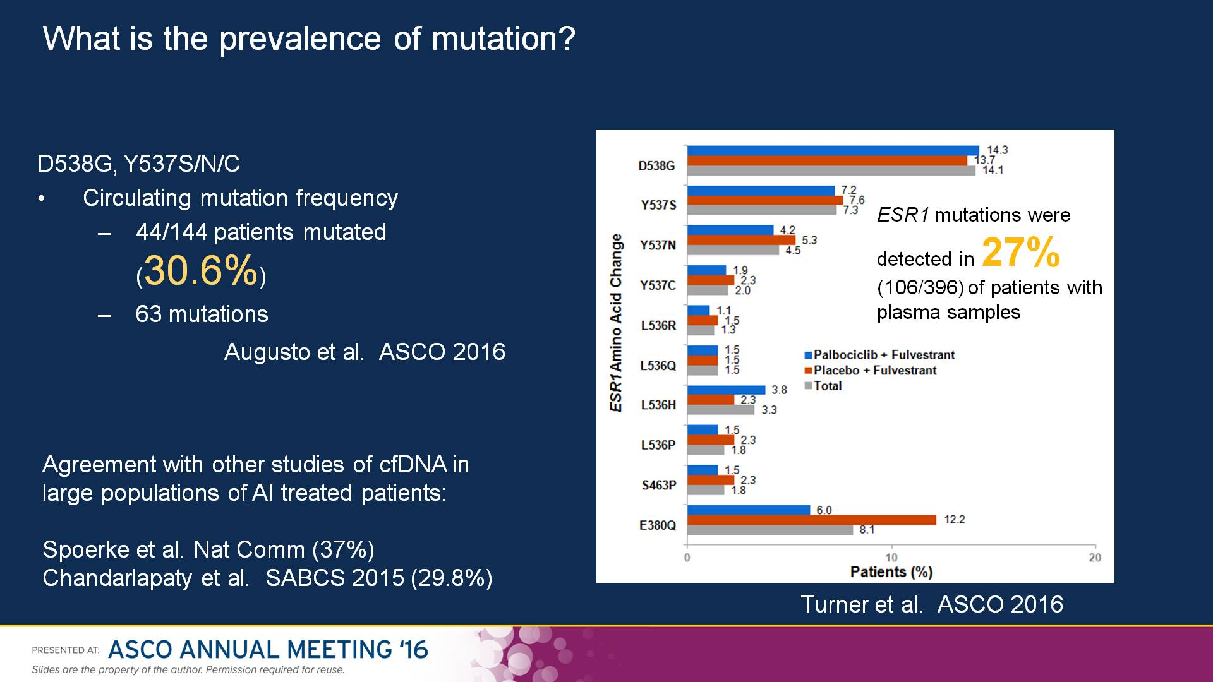
Slide 8

Slide 18
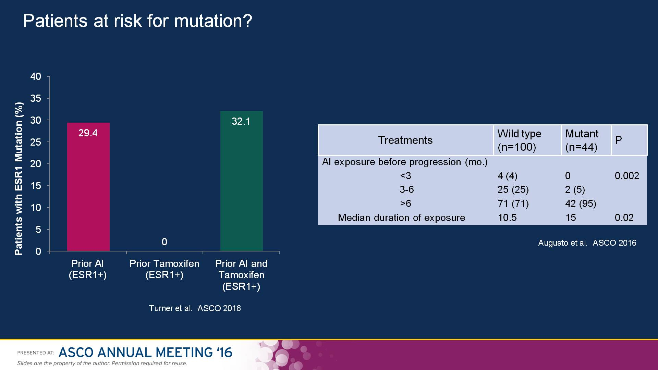
Slide 9

Slide 19
Potential Clinical Implications

Slide 20
Can we predict resistance to endocrine therapies in MBC?

Slide 21

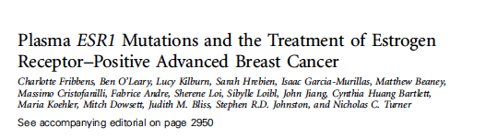
Two phase III clinical trials:
SOFEA- fulvestrant vs exemestane +/- anastrozole n=162
Paloma3- fulvestrant +/- palbociclib n=360
Hypothesis- ESR1 mutations would do better on fulvestrant vs AI
Further improvement with addition of palbociclib

Slide 22
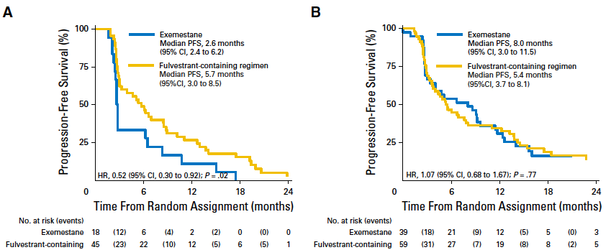
ESR1 mutations were present 39.1%, polyclonal in 46%
Detection of ESR1 mutations will influence your next choice of endocrine therapy
Fribbens et al. J Clin Oncol 2016;34:2961-2968
Notes:
Were sensitive to prior AI.
P interactton=0.07
Sensitivity= 6months or more on prior AI in 1L setting, relapse >12 months on adjuvant

Slide 23
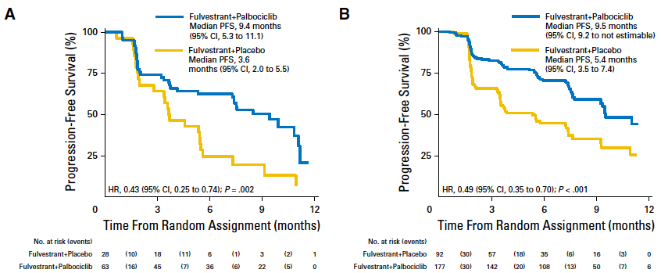
ESR1 mutations were present 25.3%, polyclonal in 28%
ESR1 mutants had marginally worse outcome on ful+palbo
Fribbens et al. J Clin Oncol 2016;34:2961-2968
Notes:
ESR1 mutations were associated with prior sensitivity to Ais
Mutations were polyclonal in 49.1% sofea and 28.6% in Paloma-3
This likely reflects inclusion of tamoxifen treated patients
ESR1 mutations continue to drive cell cycle through CDK4 and CCND1
Understand some of the molecular heterogeneity that has underpinned results of phase III studies

Slide 24

Acquired HER2 Mutations in ER+ MBC
Acquired (not observed in primary tumor)
V777L
Shared (also observed in primary tumor)
Unknown (primary tumor status unknown)
L869R
L755S
R143G
S653C
G727A
P1074L
R1153L
Kinase Domain
ERBB2
ERBB2 mutations in 7%
83% of ERBB2 mutations (5/6) in metastatic samples with matched primaries were
acquired.
Cohen et al, SABCS 2016, S1-01
Notes:
Change color of acquired to Red
Un-known to Grey
Acquired.all
144_Prospective1.p.L755S, 252_Prospective1.p.V777L, 252_Prospective1.p.G727A, 074_Prospective1.p.R143G
+315_T1. .p.V777L
PreExisting
316_T1.p.R1153L
NotPowered.Arc
322_T1.p.S653C (40% power to detect. Very low)
No.Arc
319_T2.p.V777L, 348_T1.p.I628M, 349_T1.p.P1074L, 387_T1.p.L869R, 397_T1.p.L869R

Slide 25
SUMMIT study design (A4)
Primary brain tumors – EGFR mutant/amplified
  Open-label, multinational, multihistology phase 2 signal-seeking study of neratinib as monotherapy or in combination in patients with tumors harboring EGFR, ERBB2, ERBB3 or ERBB4 mutations (NCT 01953926)
EGFR
mutant
Lung cancers with EGFR exon 18 mutations
Breast cancer
Biliary tract
Neratinib
240 mg po daily (28-day cycle)
Monotherapy or combination therapy in ERBB2 mutant cohort*
Bladder/urinary tract
PD
or
Toxicity
ERBB2 mutant tumors
Colorectal
Endometrial
Gastro-esophageal
Lung
Ovarian
Primary endpoint: Objective response rate (ORR) at 8 weeks
Secondary endpoints: ORR (confirmed); Clinical Benefit Rate (CBR); PET-CT; Progression-Free Survival (PFS); Safety; Patient-Reported Outcomes; Biomarkers
Simon 2-stage design: If ≥1 response in first evaluable 7 patients expand cohort to Stage 2 (N=18); if ≥4 responses in Stage 2, then further expand cohort or consider breakout strategy
Sample size: N≤18 / cohort; N≤30 for NOS cohorts
Solid tumors (NOS)
ERBB3
mutant
Solid tumors (NOS)
ERBB4
mutant
Solid tumors (NOS)
*HR+ MBC – fulvestrant or endocrine regimen
CRC and NSCLC – trastuzumab
Bladder cancer – paclitaxel

Slide 26
SUMMIT: distribution of ERBB2 mutations
Receptor_L
Furin-Like
Receptor_L
GF_IV
TM
Tyrosine Kinase Domain
†
#
#
†
&
D251fs*1
R1153X
D277G
N319D
V659E
R814H
R970Q
G292R
R678Q
L841V
L869R
E930D
V679L
T862A
ERBB2-GRB7 Fusion
V842I
&
P780_Y781InsGSP
G778A or G778_S779insCPG
&
V777L
L755S / L755P
G776V, G776VinsC or G776AinsVGC
L755_E757delinsS
D769H / D769Y / D769N
A775_G776insYVMA
V773M
12 bp exon 20 insertion
Tumor Legend
S310F or S310Y
Bladder
NSCLC
Cervical
ERBB2 mutation type | Incidence (n=93)
Single nucleotide variants | 70% (65/93)
Insertions/deletions | 28% (26/93)
Rearrangements | 1% (1/93)
Frameshift | 1% (1/93)
CRC
Kidney
Unknown Primary
Ovarian
Ampullary
Endometrial
MBC
Liposarcoma
Vagina SCC
LCNEC
Gallbladder
Duodenal
Gastroesophageal
Cholangiocarcinoma
Neuroendocrine small bowel
Extramammary Paget’s
#, †, &Coexisting mutations in same patient

Slide 27
Learning Objectives
Where are we?
Focus on resistance mechanisms
  ER mutations and implications
  CDK4/6 inhibitors
  mTOR inhibitors
  PI3K inhibitors

Slide 28

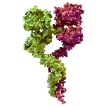
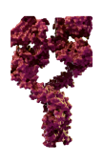
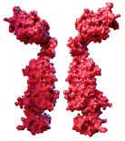

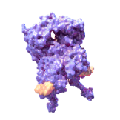
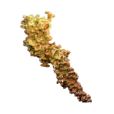
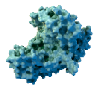
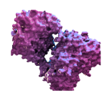
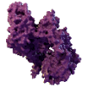
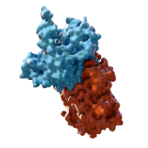
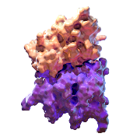
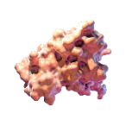

Cyclin D1 and CDK4/6 Are Downstream of Signaling Pathways That Lead to
Cellular Proliferation
EXTRACELLULAR SPACE
Estrogen⁴
Receptor tyrosine kinase⁴
EGFR²
IGF-1R²
PDGFR²
ER⁴
PI3K⁷
STATs⁵
CYTOPLASM
mTOR⁷
MAPK³
Cyclin D1
+
CDK4/6^{5,6}
Rb⁶
pRb⁶
NUCLEUS
E2F⁶
Cellular proliferation⁶
CDK=cyclin-dependent kinase; E2F=E2 transcription factor; EGFR=epidermal growth factor receptors; ER=estrogen receptor; IGF-1R=insulin-like growth factor-1 receptor; MAPK=mitogen-activated protein kinase; mTOR=mammalian target of rapamycin; PDGFR=platelet-derived growth factor receptor; PI3K=phosphoinositide 3-kinase; pRb=phosphorylated retinoblastoma; Rb=retinoblastoma; STAT=signal transducer and activator of transcription.
2. Milani A, et al. World J Clin Oncol. 2014;5:990-1001. 3. Jung HJ, Suh Y. Front Genet. 2015;5:1-13. 4. Osborne CK, et al. Annu Rev Med. 2011;62:233-247. 5. Lange CA, et al. Endocr Relat Cancer. 2011;18(4):C19-C24. 6. Asghar U, et al. Nat Rev Drug Discov. 2015;14(2):130-146. 7. Baselga J. Oncologist. 2011;16(suppl 1):12-19.
Notes:
CONVERGENCE ON CDK4/6
CDK4/6 and cyclin D are downstream of signaling pathways that lead to cellular proliferation¹
This image is a schematic representation of cyclin D1 and CDK4/6 and the key cellular players that this complex interacts with to affect cellular proliferation²⁻⁴
The CDK4/6-cyclin D1 complex acts as the central node that processes the upstream cellular signaling and then emits the signal, which permits cell cycle progression^{4,5}
REFERENCES
IBRANCE® Prescribing Information. New York, NY: Pfizer Inc; 2016.
Osborne CK, Schiff R. Mechanisms of endocrine resistance in breast cancer. Annu Rev Med. 2011;62:233-247.
Baselga J. Targeting the phosphoinositide-3 (PI3) kinase pathway in breast cancer. Oncologist. 2011;16(suppl 1):12-19.
Asghar U, Witkiewicz AK, Turner NC, Knudsen ES. The history and future of targeting cyclin-dependent kinases in cancer therapy. Nat Rev Drug Discov. 2015;14(2):130-146.
Lange CA, Yee D. Killing the second messenger: targeting loss of cell cycle control in endocrine-resistant breast cancer. Endocr Relat Cancer. 2011;18(4):C19-C24.

Slide 29
Cyclin D1-CDK 4/6 Cell Cycle Regulation
Key Processes
Controlled phosphorylation of the RB protein is essential to progression of the normal cell cycle
  In the hypo-phosphorylated state
    RB protein is active and stays coupled with E2F
    to suppress gene transcription and arrest the cell cycle in G1
  In the phosphorylated state
    RB protein is inactive, uncouples from EF2, and loses its ability to suppress gene transcription
Murphy CG and Dickler MN. Oncologist. 2015;20(5):483-490.
Dickson MA. Clin Cancer Res. 2014;20(13):3379-3383.

Slide 30
Cyclin D1-CDK 4/6 Cell Cycle Regulation
Key Processes (cont)
In response to mitogenic signals, cyclin D1 complexes with CDK 4/6, leading to the phosphorylation of RB protein
  RB protein does not serve as a tumor suppressor
  Uncontrolled cell proliferation results
Dickson MA. Clin Cancer Res. 2014;20(13):3379-3383.

Slide 31
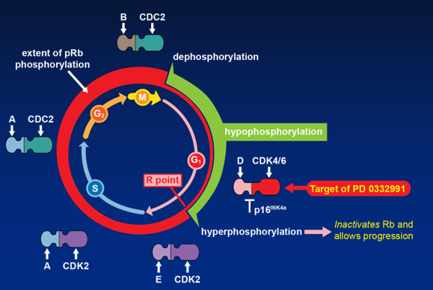
Rb as Master-Regulator of the R-Point

Slide 32
PALOMA-1/TRIO-18 Study Design (NCT00721409)
Cohort 1
Cohort 2
RANDOMIZATION*
Palbociclib 125 mg/d† +
Letrozole
2.5 mg/d
RANDOMIZATION*
Palbociclib 125 mg/d† +
Letrozole
2.5 mg/d
ER+/HER2− advanced breast cancer with CCND1 amplification and/or loss of p16
ER+/HER2− advanced breast cancer
1:1
1:1
Letrozole
2.5 mg/d
Letrozole
2.5 mg/d
n=66
n=99
Randomized phase II open-label trial involving 50 centers in 12 countries
Key eligibility criteria: inoperable ER+/HER2– locally recurrent disease, postmenopausal status, no prior therapy for advanced breast cancer, no prior CDK inhibitors, no letrozole within 12 months, no prior/current brain metastases, measurable disease (RECIST 1.0) or bone-only disease, ECOG performance status ≤1, adequate bone marrow and renal function
*Randomization stratified by disease site and disease-free interval.
† Palbociclib schedule 3/1 (28-day cycles).
Finn RS, et al. Lancet Oncol. 2015;16(1):25-35.
Notes:
Notes
PALOMA-1/TRIO-18 is an international, multicenter, open-label, randomized, phase 2 trial designed to assess the efficacy and tolerability of letrozole in combination with palbociclib versus letrozole alone in the first-line treatment of ER+/HER2- postmenopausal women with advanced breast cancer.
The study consisted of 2 sequential cohorts. Cohort 1 enrolled patients selected based on classification of ER+/HER2-; Cohort 2 included additional biomarker criteria for enrollment: cyclin D1 (CCND1) gene amplification and/or loss of p16 (CDKN2A).
Enrollment in Cohort 2 was halted (n=99) based on retrospective analysis of biomarkers from an unplanned interim analysis of Cohort 1 (based on 31 PFS events), which demonstrated clinically meaningful activity of the combination versus letrozole alone (HR: 0.35; 95% CI: 0.17–0.72; P=0.006).
The final analysis reports results from both cohorts combined (Cohort 1, n=66; Cohort 2, n=99) and was performed when 95 PFS events accumulated.
Patients were randomized 1:1 within each cohort to receive either letrozole 2.5 mg/day orally or letrozole 2.5 mg/day orally plus palbociclib 125 mg/day orally, given once daily for 3 weeks on treatment and 1 week off treatment over a 28-day cycle.
Randomization was stratified by disease site (visceral, bone-only, or other) and disease-free interval (DFI>12 months from the end of adjuvant treatment to disease recurrence or ≤12 months from the end of adjuvant treatment to disease recurrence or de novo presentation with advanced disease).

Slide 33
PALOMA-1/TRIO-18: PFS (ITT Population)
100
90
Palbociclib plus letrozole
Letrozole
80
70
60
Progression-free survival, %
50
40
30
20
10
HR 0.488 (95% CI 0.319–0.748; one-sided P = .0004)
0
0
4
8
12
16
20
24
28
32
36
40
Number at risk
Time, months
Palbociclib plus letrozole
84
67
60
47
36
28
21
13
8
5
1
Letrozole
81
48
36
28
19
14
6
3
3
1
Finn RS, et al. Lancet Oncol. 2015;16(1):25-35.
Notes:
33
Notes
At the time of this analysis, median PFS was 20.2 months (95% CI, 13.8-27.5) for the palbociclib plus letrozole arm and 10.2 months (95% CI, 5.7-12.6) for the letrozole alone arm demonstrating a significant decrease in the risk of progression by the addition of palbociclib to letrozole (HR=0.488; 95% CI, 0.319 -0.748; 1-sided P=0.0004).

Slide 34
PALOMA-1/TRIO-18: All-Causality AEs Occurring in ≥10% of Patients (Safety Population) (1/2)
Adverse event, % | PAL + LET (n=83) |  | LET (n=77)
 | All grades | Grade 3/4 | All grades | Grade 3/4
Any adverse event | 99 | 76 | 84 | 21
Neutropenia | 75 | 54 | 5 | 1
Leukopenia | 43 | 19 | 3 | 0
Fatigue | 41 | 5 | 23 | 1
Anemia | 35 | 6 | 6 | 1
Nausea | 25 | 2 | 13 | 1
Arthralgia | 23 | 1 | 16 | 3
Alopecia | 22 | n/a | 3 | n/a
Diarrhea | 20 | 4 | 10 | 0
Hot flush | 21 | 0 | 12 | 0
Thrombocytopenia | 17 | 2 | 1 | 0
Decreased appetite | 16 | 1 | 7 | 0
Dyspnea | 16 | 2 | 8 | 1
Nasopharyngitis | 16 | 0 | 10 | 0
Back pain | 11 | 0 | 16 | 1
No cases of febrile neutropenia were reported
One (1%) grade 5 event occurred in the PAL + LET group (from disease progression); none occurred in the LET group.
Finn RS, et al. Lancet Oncol. 2015;16(1):25-35.
Notes:
Notes
All adverse events, regardless of causality were collected and analyzed. The most common AEs reported for the combination arm were neutropenia, leukopenia, and fatigue.
Despite the increase in all grades of neutropenia and leukopenia, no cases of neutropenic fever were reported.
Other adverse events (all causality) that were increased in the palbociclib plus letrozole treatment arm included anemia (29 patients; 35%), nausea (21 patients; 25%), arthralgia (19 patients; 23%), and alopecia (18 patients; 22%), but these were all generally of low grade. Of these, anemia and alopecia were statistically different with 2-sided P values of P<0.0001 and P=0.0002, respectively.

Slide 35
Consistent Clinical Benefit Seen
Across PALOMA Studies
 | 1003¹ (PALOMA-1) | 1008 (PALOMA-2) | 1023² (PALOMA-3)
Design | Phase 2 Open label | Phase 3 Placebo control | Phase 3 Placebo control
Endocrine partner | Letrozole | Letrozole | Fulvestrant
Patients on study, n | 165 | 666 | 521
Efficacy (palbociclib vs control arm)
Primary endpoint: PFS
HR | 0.49 | 0.58 | 0.46
Median PFS, mo | 20.2 vs 10.2 ( 10 mos) | 24.8 vs 14.5 ( 10.3 mos) | 9.6 vs 4.6
Secondary endpoints, %
ORR (ITT, measurable disease) | 43 vs 33, 55 vs 39 | 42 vs 35, 55 vs 44 | 19 vs 9, 25 vs 11
CBR (ITT) | 81 vs 58 | 85 vs 70 | 67 vs 40
CBR=clinical benefit response; ITT=intent-to-treat; ORR=objective response rate.
Finn et al. Lancet Oncol. 2015.
Cristofinallli et al. Lancet Oncol. 2016.
Notes:
PALOMA-1: Finn 2015 pg. 32/A paragraph 2 –Verified JVS 5/15/16
PALOMA-2:
ITT Pop: Table 14.2.3.1.1 (BOR_Confirmed file); Table 14.2.5.1.1_conf_CBR – Verified JVS 5/15/16
MesDis: Table 14.2.3.2.1_conf_Meas.DisBOR -Verified OR but not CBR JVS 5/15/16
PALOMA-3: Cristofanilli 2016 pg. 8 Table – Verified JVS 5/15/16
Turner et al 2015/p1/Summary/Methods
Finn et al 2015/p1/Summary/Findings
Finn et al 2015/p1/Summary/Methods
Turner et al 2015/p1/Summary/Results

Slide 36
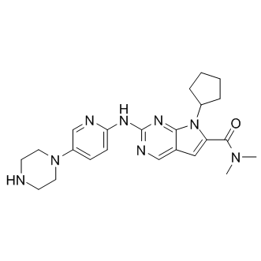
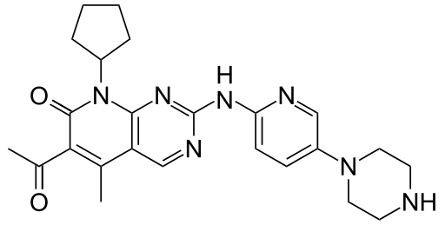
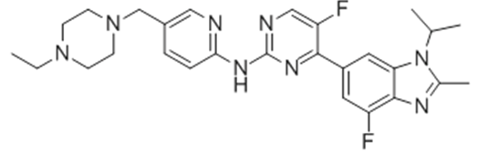
CDK 4/6 Inhibitors Approved by the FDA or in Development
FDA Approved
(February 2015)
In Development
Palbociclib
PD 0332991
Ribociclib
LEE011
Abemaciclib
LY2835219

Slide 37
Phase III studies in ER+/HER2- MBC
 | Palbociclib (PD-0332991) |  |  | Ribociclib (LEE-011 ) |  |  | Abemaciclib (LY2835219) |  | Fulvestrant
Study | PALOMA-2 | PALOMA-3 | PEARL | MONALEESA-2 | MONALEESA-3 | MONALEESA-7 | MONARCH-2 | MONARCH-3 | FALCON
Setting | 1st line | 1st or later line | Later line | 1st line | 1st or 2nd line | 1st line | 1st or 2nd line | 1st line | 1st line
Menopausal status | Post | Pre and Post | Post | Post | Post | Pre | Pre and Post | Post | Post
Target No. patients | 650 | 521 | 348 | 667 | 660 | 660 | 630 | 450 | 524
Endocrine partner | Letrozole | Fulvestrant | Exemestane or Fulvestrant | Letrozole | Fulvestrant | Anastrozole or letrozole, or tamoxifen | Fulvestrant | Anastrozole or letrozole | Fulvestrant + placebo vs. anastrozole +placebo
Primary endpoint | PFS | PFS | PFS | PFS | PFS | PFS | PFS | PFS | PFS
May 2016:
Stopped at interim for efficacy

Slide 38
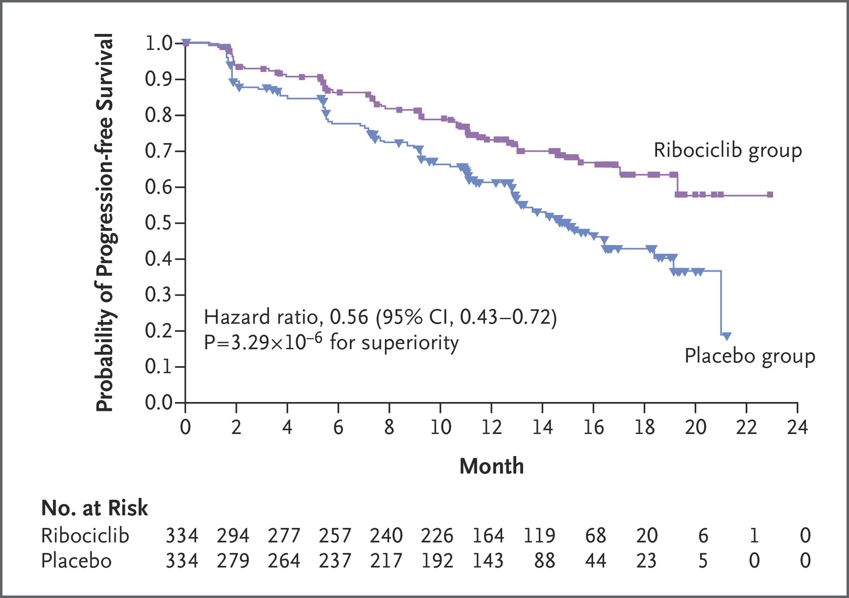

Hortobagyi GN et al. N Engl J Med 2016. DOI: 10.1056/NEJMoa1609709
Kaplan–Meier Analysis of Progression-free Survival.
MONALEESA -2
At 18 ms, PFS 63% ribo v. 42% PLA
Notes:
Figure 1. Kaplan–Meier Analysis of Progression-free Survival. After 18 months, the progression-free survival rate was 63.0% (95% CI, 54.6 to 70.3) in the ribociclib group and 42.2% (95% CI, 34.8 to 49.5) in the placebo group. The median duration of progression-free survival was not reached in the ribociclib group and was 14.7 months in the placebo group.

Slide 39
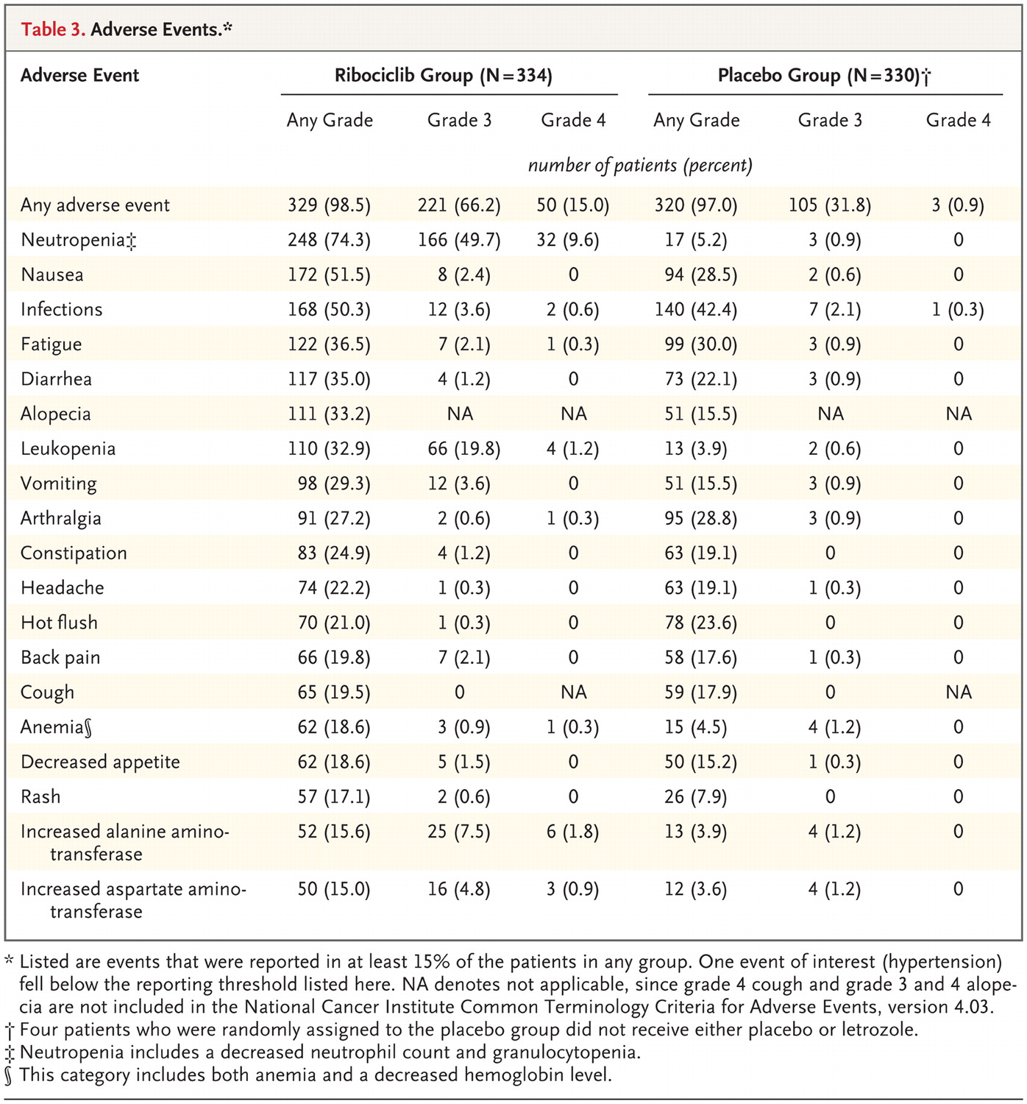
Hortobagyi GN et al. N Engl J Med 2016.
MONALEESA -2
Adverse Events.

Slide 40
MONARCH-1 Results¹
Prior therapy for ABC | Median of 3 lines (Range: 1-8); 2 prior chemotherapies
ORR | 19.7% (95% CI: 13.3-27.5; 15% not excluded)
CBR | 42.4%
PFS | 6.0 months
OS | 17.7 months
TEAE, % | Grade 1 | Grade 2 | Grade 3 | Grade 4 | All Grade
Diarrhea Fatigue Nausea Decrease appetite Abdominal pain Vomiting Headache | 41.7 21.2 39.4 28.0 22.0 22.7 13.6 | 28.8 31.1 20.5 14.4 14.4 10.6 6.8 | 19.7 12.9 4.5 3.0 2.3 1.5 0 | 0 0 0 0 0 0 0 | 90.2 65.2 64.4 45.5 38.6 34.8 20.5
Creatinine increased WBC decreased Neutrophil decreased Anemia Platelet count decreased | 46.9 18.5 17.7 30.0 28.9 | 50.8 44.6 43.1 38.5 10.2 | 0.8 27.7 22.3 0 2.3 | 0 0 4.6 0 0 | 98.5 90.8 87.7 68.5 41.4
Discontinuation due to AEs | 7.6%
1. Dickler MN, et al. Presented at the American Society of Clinical Oncology Annual Meeting 2016; June 3-7, 2016; Chicago, IL. Abstract 510.

Slide 41
Learning Objectives
Where we were
Focus on resistance mechanisms
  ER mutations and implications
  CDK4/6 inhibitors
  mTOR inhibitors
  PI3K inhibitors

Slide 42
Target of Rapamycin (TOR)
Highly conserved from yeast to mammals
2 distinct complexes: mTORC1 and mTORC2
  Regulate different processes
  Not equally effected by rapalogs/mTOR inhibitors
  Different associated proteins (complexes)

Slide 43
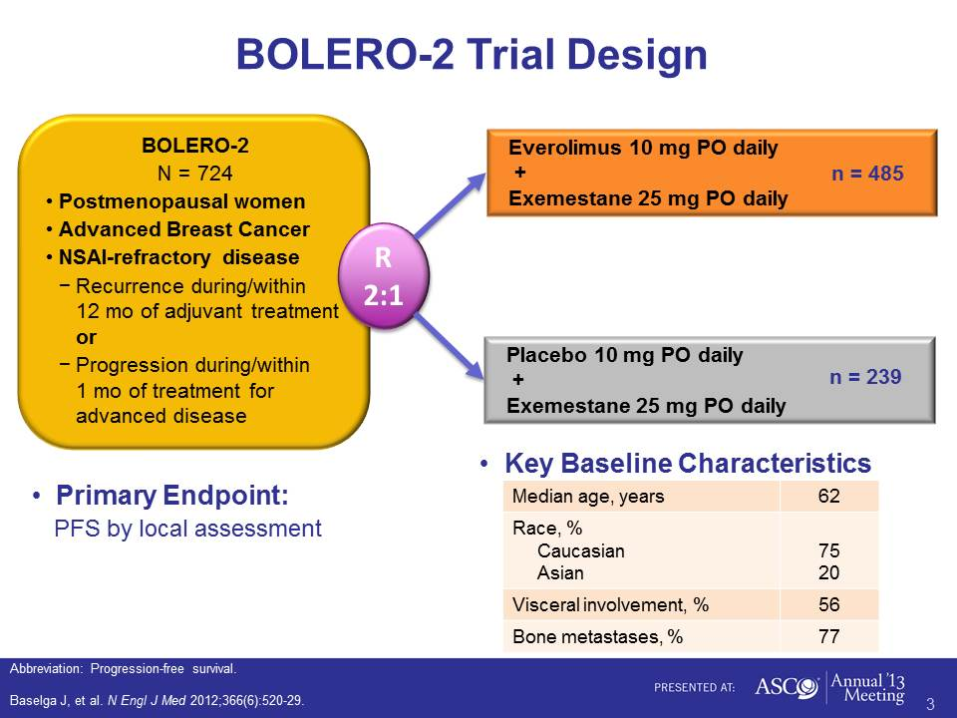
[TITLE]

Slide 44
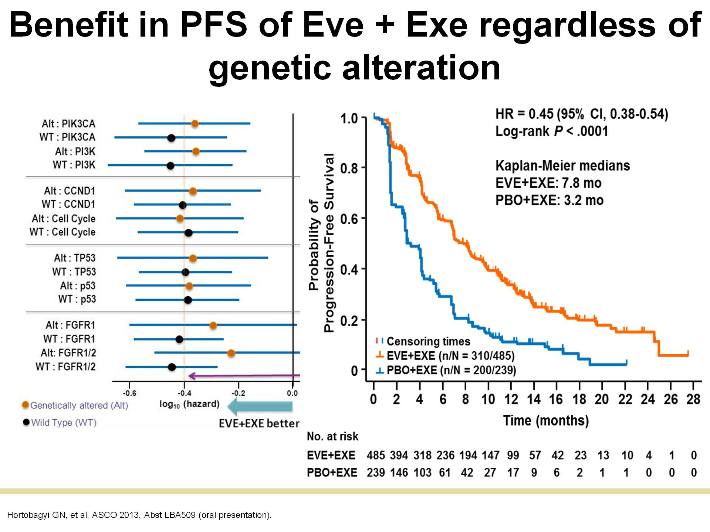
Benefit in PFS of Eve + Exe regardless of genetic alteration

Slide 45

Methods: Study Schema
San Antonio Breast Cancer Symposium, December 6-10, 2016
1:1 Randomization
Stratify:
ECOG PS: 0 vs. 1
Measurable Disease (y/n)
Prior Chemo for Mets (y/n)
Arm A
Fulvestrant 500 mg day 1 and 15 of cycle 1, then day 1 of cycles 2-12 (28d cycles)
Everolimus 10 mg PO QD
Arm A & B (week 48)
Unblind and continue
Fulvestrant +/- Everolimus
Arm B
Fulvestrant 500 mg day 1 and 15 of cycle 1, then day 1 of cycles 2-12 (28d cycles)
Placebo PO QD
Induction Phase
Continuation Phase
Induction Phase: Treat until evidence of progressive disease or unacceptable toxicity for a maximum of 12 cycles (48 weeks)
Continuation Phase: If no disease progression or unacceptable toxicity after 12 cycles, unblind and continue fulvestrant +/- everolimus
Treatment Plan: Tumor measurements every 12 weeks (+/- 1 week) by local treating physician
Supportive Care: Corticosteroid mouthwash prophylaxis was not used
Kornblum SABCS 2016, S1-02
Notes:
The study schema is shown here:
Patients were stratified by ECOG performance status, presence of measurable disease, and prior chemotherapy status
They were then randomized 1:1 for treatment with high dose fulvestrant with either everolimus or matching placebo
In the induction phase patients received their assigned treatments until evidence of POD or unacceptable toxicity, for a maximum of 12 cycles (48 weeks)
Patients who did not experience Progression or unacceptable toxicity were un-blinded and allowed to proceed to the continuation phase of the study and remain on fulvestrant with or without everolimus
Tumor measurements were performed every 12 weeks
Of note, Corticosteroid mouthwash prophylaxis was not used

Slide 46
Progression Free Survival
(by investigator assessment – primary study endpoint)
San Antonio Breast Cancer Symposium, December 6-10, 2016
Kornblum SABCS 2016, S1-02
Notes:
Here we see the Kaplan-Meier curve of progression free survival the primary study endpoint
There were 101 events at the time of the analysis, which exceeded the minimum of 98 events required
The addition of everolimus improved the median PFS from 5.1 to 10.4 months
The hazard ratio for PFS was 0.60 favoring the everolimus arm, with 95% confidence intervals of .40 to .92
The stratified long rank p value was .02, indicating that the primary trial endpoint was met

Slide 47
Learning Objectives
Where we are
Focus on resistance mechanisms
  ER mutations and implications
  CDK4/6 inhibitors
  mTOR inhibitors
  PI3K inhibitors

Slide 48
Distribution of Mutations in TCGA by Breast Caner Subtype

Slide 49
FERGI Study Design – Part I
ER+, HER2-, postmenopausal women with advanced or MBC
Prior aromatase inhibitor in adjuvant (PD<6mo) or metastatic setting
ECOG PS 0, 1
No diabetic patients
0-1 chemotherapy or ≤2 prior endocrine therapies
Fulvestrant 500mg¹ +
pictilisib (GDC-0941)
340 mg QD
Treat to PD²
R
1:1
Fulvestrant 500 mg¹ +
placebo QD
Cross
Over
pictilisib + fulvestrant
N = 168
Treat to PD²
Stratification factors | 1° objective | 2° objectives
PIK3CA-MT and PTEN loss³ Measurable disease 1º vs. 2º resistance⁴ | PFS in the ITT PFS in PIK3CA-MT pts Safety | Objective response rate Duration of objective response PK
¹ Administered on D1 of each 28 day cycle and C1D15; ² Tumor assessments performed every 8 weeks; ³Exons 9 and 20 in the codons encoding amino acids E542, E545, and H1047 were detected by RT-PCR; ⁴ Disease relapse during or within 6 months of completing AI treatment in the adjuvant setting, or disease progression within 6 months of starting AI treatment in the metastatic setting. ⁵ Data presented is with an additional year of follow up per-protocol primary analysis
  Median duration of follow up 17.5 months
Krop SABCS 2014, S2-02

Slide 50
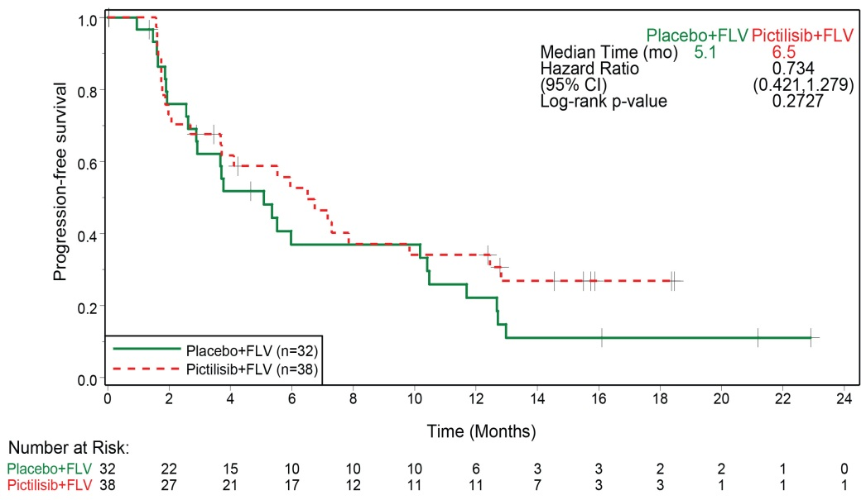
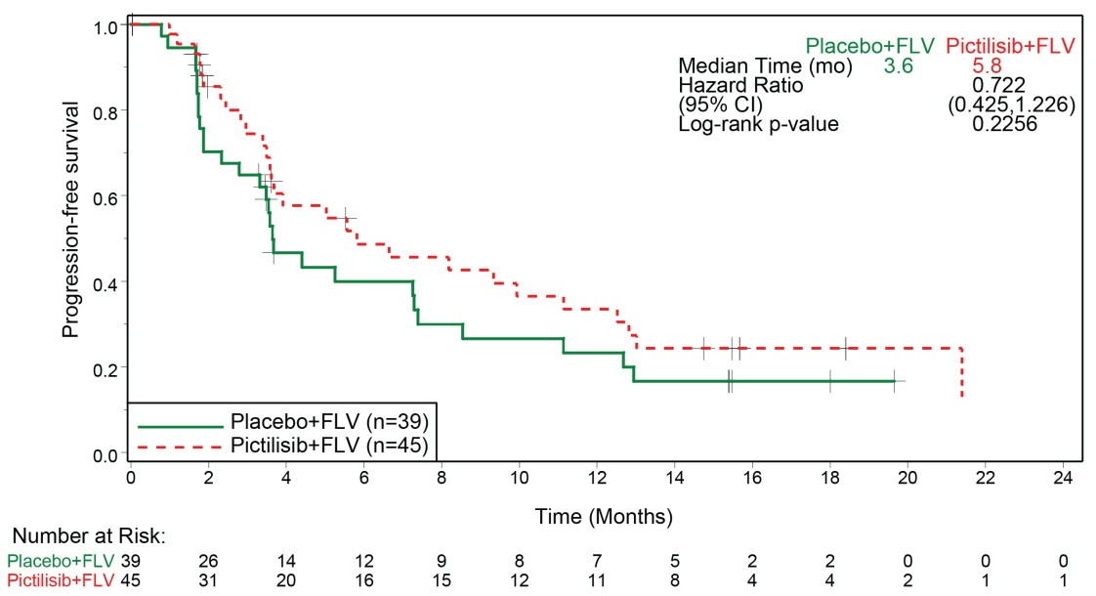
Progression-Free Survival Based on
Tumor PIK3CA Mutation Status
PIK3CA-Mutant Population
PIK3CA “Wild-Type” Population
PIK3CA mutation status does not predict benefit of the addition of pictilisib to fulvestrant
Krop SABCS 2014, S2-02

Slide 51
Emerging Role of Liquid Biopsy in MBC
Prognostic and Predictive value
Driver and actionable mutations
Tumor Heterogeneity

Slide 52
BELLE-3 Study Design and Endpoints
Postmenopausal women with HR+/HER2–, AI-pretreated, locally advanced or metastatic breast cancer
Progression on or after an mTOR inhibitor as last line
of treatment
N=432
Buparlisib (100 mg/day)
+ fulvestrant (500 mg)
n=289
Primary endpoint
PFS (locally assessed per RECIST v1.1)
Key secondary endpoint
OS
Other secondary endpoints
PFS by PIK3CA status (ctDNA)
OS by PIK3CA status (ctDNA)
ORR and CBR in the full population and by PIK3CA status (ctDNA)
Safety, pharmacokinetics, quality of life
Randomization (2:1)
Stratified by visceral disease status
Placebo
+ fulvestrant (500 mg)
n=143
  Tumor assessments were performed every 6 weeks
  90% power to detect a 33% risk reduction in PFS (disease progression or death) at one-sided α=0.025, based on the observation of 313 PFS events
AI, aromatase inhibitor; CBR, clinical benefit rate; ctDNA, circulating tumor DNA; HER2–, human epidermal growth factor receptor 2-negative; HR+, hormone receptor-positive;
mTOR, mammalian target of rapamycin; ORR, overall response rate; OS, overall survival; PFS, progression-free survival; RECIST, Response Evaluation Criteria In Solid Tumors.
BELLE-3: ClinicalTrials.gov NCT01633060.
DiLeo A, SABCS 2016, S4-07

Slide 53
Progression-free Survival per Investigator Assessment
(Primary Endpoint)
100
Full Population (N=432) | Buparlisib + Fulvestrant n=289 | Placebo + Fulvestrant n=143
Median PFS, months (95% CI) | 3.9 (2.8–4.2) | 1.8 (1.5–2.8)
HR (95% CI) | 0.67 (0.53–0.84)
One-sided p-value | <0.001
80
60
6-month PFS rate:
31% vs. 20%
Probability of
Progression-free Survival, %
40
20
0
0
2
4
6
8
10
12
14
16
18
20
22
24
26
Time, Months
PFS results by independent central review were consistent with local assessment:
  HR 0.57 (95% CI: 0.44–0.74; one-sided p<0.001)
CI, confidence interval; HR, hazard ratio.
DiLeo A, SABCS 2016, S4-07

Slide 54
Progression-free Survival by
PIK3CA Status
Mutant
Wild-type
100
Tissue (mutant) | Buparlisib + Fulvestrant | Placebo + Fulvestrant
Median PFS, months (95% CI) | 4.7 (2.9–6.7) | 1.4 (1.4–2.2)
HR (95% CI) | 0.39 (0.23–0.65); p<0.001
100
Tissue (WT) | Buparlisib + Fulvestrant | Placebo + Fulvestrant
Median PFS, months (95% CI) | 2.8 (2.0–3.7) | 2.7 (1.4–2.9)
HR (95% CI) | 0.83 (0.60–1.14); p=0.117
  Primary tumor tissue (PCR) N=321
  PIK3CA mutant: 34%
80
80
60
60
Probability of PFS, %
40
40
20
20
0
0
0
2
4
6
8
10
12
14
16
18
20
0
2
4
6
8
10
12
14
16
18
20
22
24
26
  ctDNA samples at study entry (BEAMing) N=348
  PIK3CA mutant: 39%
100
ctDNA (mutant) | Buparlisib + Fulvestrant | Placebo + Fulvestrant
Median PFS, months (95% CI) | 4.2 (2.8–6.7) | 1.6 (1.4–2.8)
HR (95% CI) | 0.46 (0.29–0.73); p<0.001
100
ctDNA (WT) | Buparlisib + Fulvestrant | Placebo + Fulvestrant
Median PFS, months (95% CI) | 3.9 (2.8–4.3) | 2.7 (1.5–3.6)
HR (95% CI) | 0.73 (0.53–1.00); p=0.026
80
80
60
60
Probability of PFS, %
40
40
20
20
0
0
0
2
4
6
8
10
12
14
16
18
20
22
24
26
0
2
4
6
8
10
12
14
16
18
20
22
24
26
PCR, polymerase chain reaction; WT, wild-type.
p-values are one-sided.
Time, Months
Time, Months
DiLeo A, SABCS 2016, S4-07

Slide 55
Taselisib (b-sparing PI3K inhibitor) shows increased potency against PIK3CA mutant cells (Abstract 6-04)
4 day Celltiter glo assay; Each dot represents IC50 of a different cancer cell line
Pictilisib GDC-0941 IC50
BKM120 IC50
Taselisib GDC-0032 IC50
*Alpelisib BYL719 IC50
Kyle Edgar, Jeff Wallin
*Being evaluated in SOLAR trial
Friedman, SABCS 2016, S6-04

Slide 56
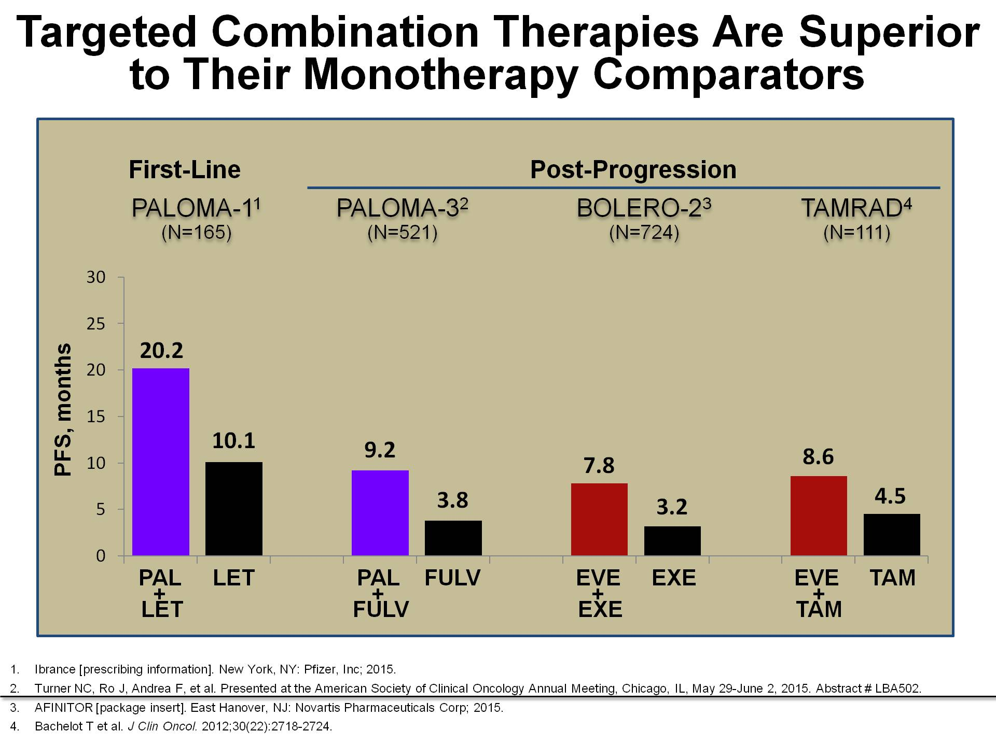
Targeted Combination Therapies Are Superior to Their Monotherapy Comparators
Finn R, et al. Breast Can Res, 2016
Everolimus package insert

Slide 57
Clinical Issues/No Answers
Who are the exceptional responders to endocrine monotherapy?
Can biomarkers be identified to define optimal therapy
CDK4/6 inhibitors in sequence?
Optimal sequence or combination of targeted therapy with endocrine therapy

Slide 58
TNBC

Slide 59
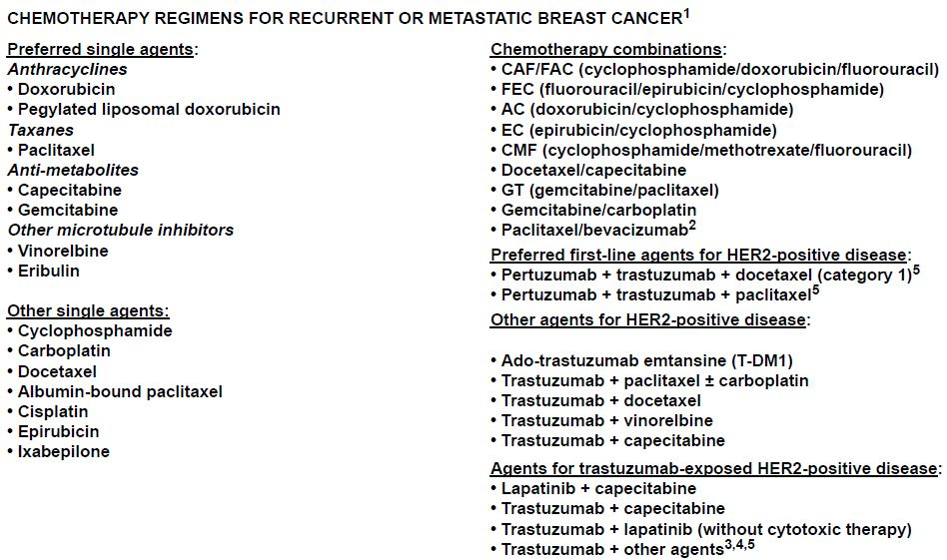

© 2017 National Comprehensive Cancer Network, Inc. All rights reserved. These guidelines and this illustration may not be reproduced in any form without the express written permission of NCCN®. To view the most recent and complete version of the NCCN Guidelines, go to NCCN.org.

Slide 60
Targeting Basal-Like TNBC
Platinum in Unselected and gBRCA mTNBC
Regimen | N | ORR (%) | PFS (mths) | Prior Adj Chemo (%)
Iniparib Trials ¹Gem / Carbo 1st line 2nd/3rd line | 258 148 110 | 30% | 4.1 4.6 2.9 | 90%
²Ph II gBRCA1m 1st line 2nd line | 20 11 9 | 80% | (TTP) 12 | 65%
TBCRC009 ³Carbo / Cis 1st and 2nd line | 86 11 gBRCAm | 26% 55% gBRCAm 20% gBRCAwt | 2.9 | 86%
1. O’Shaughnessy J, et al. JCO 2014 2. Byrski et al Breast Cancer Res 2012 3. Isakoff S, et al. JCO 2015

Slide 61
TNT Trial Design
ER-, PgR-/unknown & HER2- or known gBRCA1/2 mut
Metastatic or recurrent locally advanced
BRCAness A Priori subgroup analyses:
Germline BRCA1/2 mutation
Mutational Signatures of Homologous Recombination Deficiency (HRD)
BRCA1 methylation in tumour DNA
BRCA1 mRNA silencing in tumour RNA
376 patients Randomised
(1:1)
Carboplatin (C)
AUC 6 q3w, 6 cycles
Docetaxel (D)
100mg/m² q3w, 6 cycles
On progression,
crossover if appropriate
On progression,
crossover if appropriate
Docetaxel (D)
100mg/m² q3w, 6 cycles
Carboplatin (C)
AUC 6 q3w, 6 cycles
Tutt A. SABCS 2014
Notes:
TNT is a large phase III trial in advanced Triple Negative or BRCA1/2 associated breast cancer of any receptor status seeking to test hypotheses of differential platinum sensitivity in biological sub-groups within this heterogenous Triple Negative group
We pre-specified sub-group analyses testing the hypothesis in those with BRCA germline mutation, mutational signatures of HR Deficiency or methylation of BRCA1 causing epigenetic silencing of BRCA1 mRNA.
The latter are new analyses reported today.

Slide 62
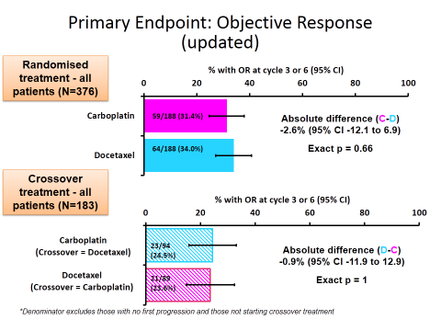
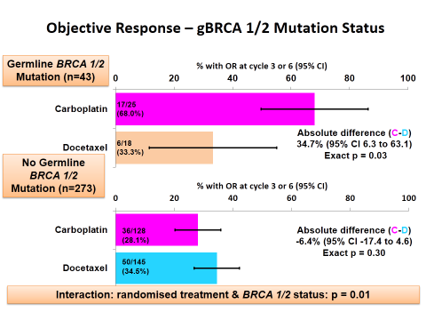
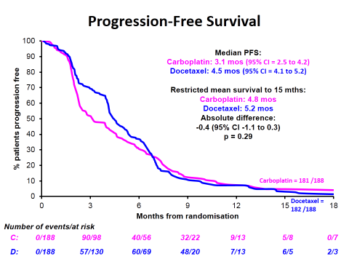
HRD did not predict benefit from carboplatin
Tutt A. SABCS 2014

Slide 63
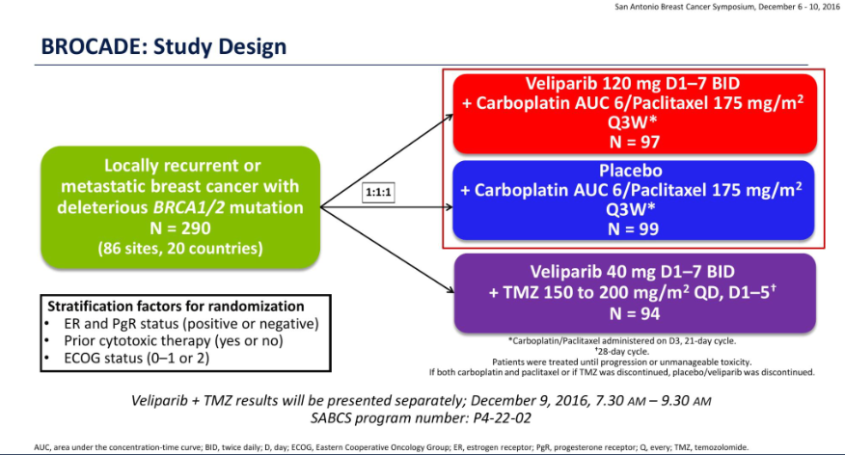
Courtesy of Han et al. , S2-05 SABCS 2016

Slide 64
BROCADE:
Platinum in MBC with BRCA1/2 mutations
280 patients randomized to carboplatin/paclitaxel with placebo or veliparib
Up to 2 prior lines of chemotherapy for MBC
  42% TNBC
Results
  Not much difference in hematologic toxicity with addition of veliparib
  No difference in PFS regardless of receptor status
    12.3 vs 14.1 months (HR 0.789, p=.231)
  Response rates higher with veliparib
    61.3% (49/80) vs 77.8% (56/72), p=0.027
BROCADE3 ongoing: maybe the addition of platinum is good enough?
Han et al, SABCS 2016

Slide 65
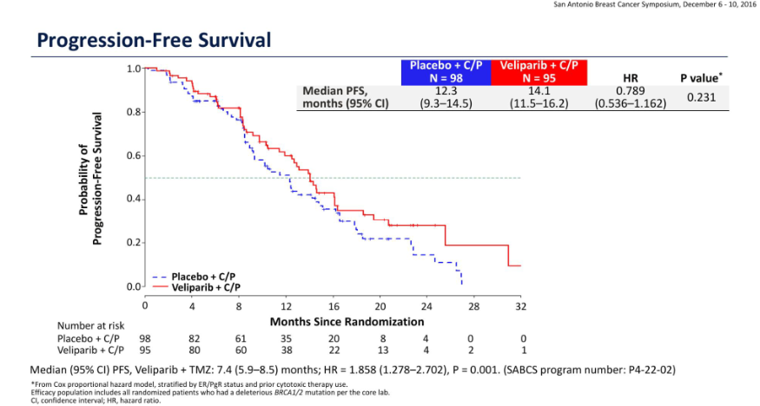
Courtesy of Han et al. , S2-05 SABCS 2016

Slide 66
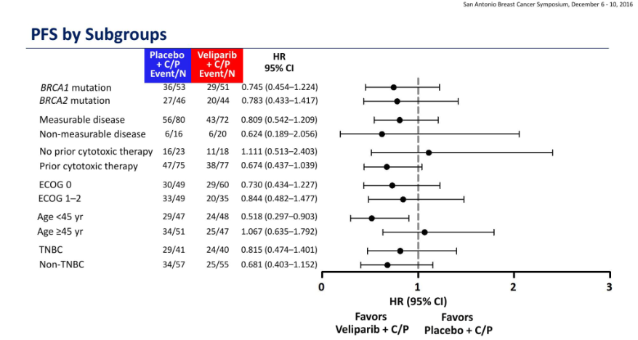
Courtesy of Han et al. , S2-05 SABCS 2016

Slide 67
HER2+ MBC
CLEOPATRA
PERTAIN

Slide 68
© 2017 National Comprehensive Cancer Network, Inc. All rights reserved. These guidelines and this illustration may not be reproduced in any form without the express written permission of NCCN®. To view the most recent and complete version of the NCCN Guidelines, go to NCCN.org.

Slide 69
S1-08

Slide 78
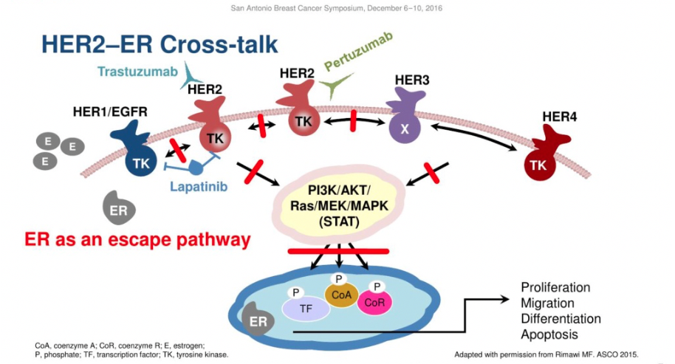

Slide 79
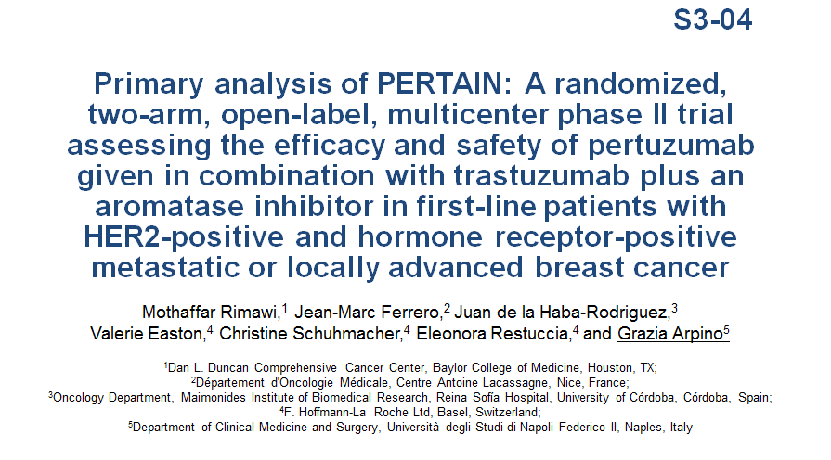
HER 2 Positive Breast Cancer

Slide 80
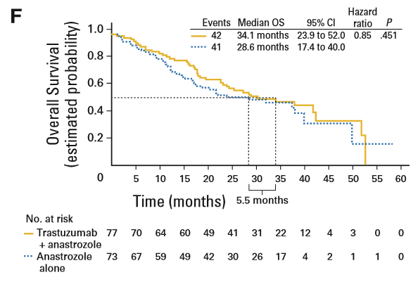
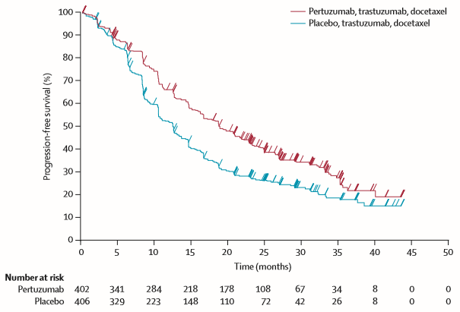
PERTAIN: Study Rational
TAnDEM: The addition of trastuzumab to anastrozole significantly improved PFS vs. anastrozole alone in HER2-positive/hormone
receptor-positive MBC⁷
CLEOPATRA: The addition of pertuzumab to trastuzumab + docetaxel significantly improved PFS and OS vs. trastuzumab + docetaxel in first-line, HER2-positive MBC
Kaufman B, et al. J Clin Oncol 2009; 27:5529–5537
Swain SM, et al. N Engl J Med 2015; 372:724–734
Does Pertuzumab + trastuzumab + AIs offer additional benefits?

Slide 81
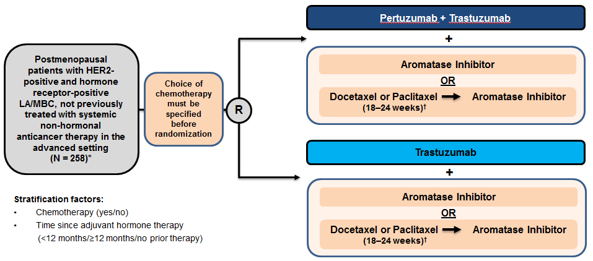
PERTAIN: Study Design

Slide 82
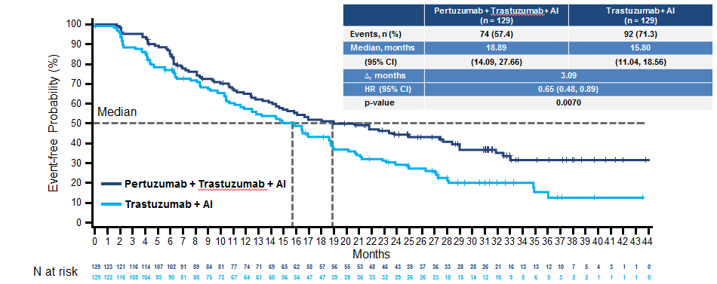
PERTAIN: PFS ITT Analysis

Slide 83
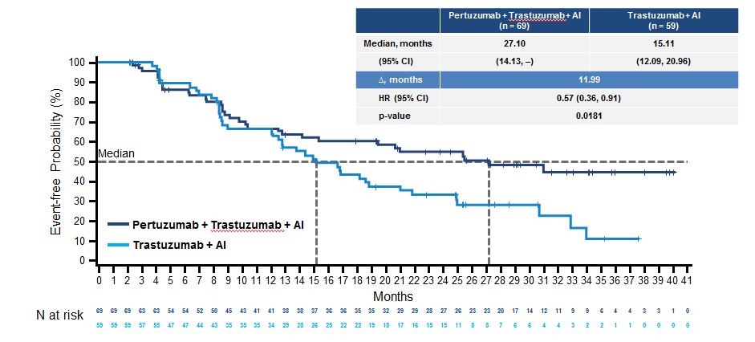
PERTAIN: Duration of Response

Slide 84
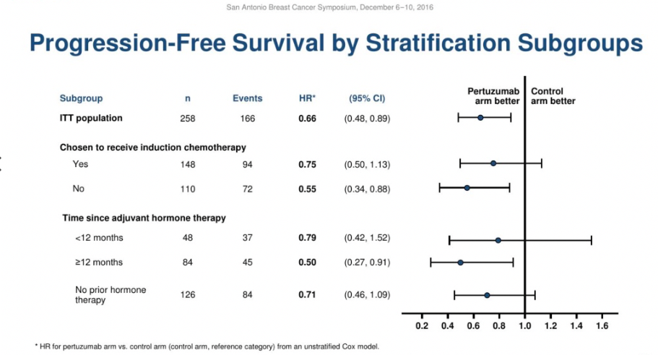

Slide 85


Slide 86
PERTAIN: Conclusions
Primary endpoint - progression free survival Pertuzumab + Trastuzumab + AI was superior to Trastuzumab + AI
Secondary endpoints of Overall Response Rate and Duration of Response also favored addition of Pertuzumab
Subgroup analyses supported the overall analyses
Combination therapy with Pertuzumab + Trastuzumab + AI was well tolerated and no new safety concerns.

Slide 87
Conclusions
Many more options in ER+ MBC
Defining the best therapy for a given patient at the appropriate time remains challenging
TNBC- many drugs, many strategies, but chemo remains SOC
HER2 +: can justify HER2 targeted therapy with endocrine in select patients.

Slide 88

The Big Challenge
Libero Santarpia et al. The Oncologist 2016;21:1063-1078
Notes:
Biological and clinical consequences of tumor heterogeneity. (A): Tumor dissemination may occur at earlier stages of cancer progression, resulting in substantial divergences between primary and metastatic lesions. Alternatively, cell subpopulations in the primary tumor evolve by acquiring multiple genetic aberrations and aggressive phenotypes, ultimately leading to a late-stage metastatic dissemination. (B): Distinct subclones may harbor constitutive alterations that confer different drug sensitivity. Cancer therapy may trigger clonal evolution and increase intratumoral heterogeneity, allowing for the selection of cells with advantageous genetic aberrations. Further evolution of the resistant clone in response to therapy may lead to relapse after initial treatment response.

